Slide 1
All the World’s A Stage
Introduction to Shakespeare Notes

Slide 2
Today’s
Focus Questions:
Goals:
Who is Shakespeare?
Why is Shakespeare so hard to read?
How can I get better at reading Shakespeare?
Why are we reading Shakespeare?
Why is Shakespeare still relevant today?
Understand what this unit is about
Determine why this unit is being taught

Slide 3
Unit 3 Overview

Slide 4
Drama: All that Drama- Falling in love
OVERVIEW
“[A]nd yet, to say the truth, reason and love keep little company together now-a-days.” ~Bottom, William Shakespeare, A Midsummer Night’s Dream
What are we doing and why?

Slide 5
Standards
RL. 9-10.9
Analyze how an author adopts or adapts source material in a specific work.
L.9-10.5
Demonstrate understanding of figurative language and nuances in word meanings.
RL.9-10.5
Analyze how an author’s choices concerning how to structure a text, order events within it, and manipulate time create effects such as mystery, tension, or surprise.

Slide 6
ON THE BACK
Highlight or circle items from this page that you already know and understand.
Highlight in another color, or box items from this page that you are most interested in learning.
Review at the end of the unit and CHECK off the items you now know.

Slide 7
EQ’s
What factors create and influence our perceptions?
Shakespeare will asks us to determine what makes people fall in (and out) of love. He will also question what makes people make the decisions they do?
How do the writings of Shakespeare provide us with a glimpse into the past but still connect us to the present?​
Okay, this guy is old. The writing is… well, old, and seriously old sounding. So how is this still relevant today?
How do the conventions of the theater reinforce the meaning of the play?
What is unique about theater and plays that you can’t find in text? Remember we looked at how film and text differ? What about plays?

Slide 8
Vocabulary
We’ll cover most of these tomorrow, and go into detail about irony
Later in the unit we will cover METER and SONNETS
Through the text we will examine CONNOTATION and DENOATION

Slide 9
Focus Questions:
Who is Shakespeare and why are his work relevant to me?
How can I understand Shakespeare’s language?
How do we analyze plays?
What is the difference between standard syntax and nonstandard syntax?
What is a sonnet?
How does understanding meter impact my understanding of a text?
what is the difference between dreams and reality?
What happens to people when they are in love?
How can I keep track of a play with lots of characters?

Slide 10
Student Outcomes:
I can…
appreciate and understand Shakespearean language
Paraphrase Shakespearean language into contemporary restatements of the same ideas
make connections between fictional stories and real-life scenarios
understand how authors create suspense, tension, and mystery in the story
write analytically using the text to cite any inferences

Slide 11
ENDURING UNDERSTANDINGS: What are the big ideas?
Emotions have the power to “blind” or persuade people to do things they were otherwise not do.
The boundary line between dreams and reality might not be as wide as we think.
Texts can have universal themes which once understood, will transcend time and space.
Love can be a tricky thing to define, to protect, and hold on to.

Slide 12
Brief Introduction
More on this next week!

Slide 13
Who is Shakespeare?
Movie Link: 5 minutes
https://www.youtube.com/watch?v=geev441vbMI

Slide 14
Why is Shakespeare so Hard to read?
His plays are written in Early Modern English (NOT OLD ENGLISH) which is actually very much like contemporary English but with some words like thee that trip people up.

Slide 15
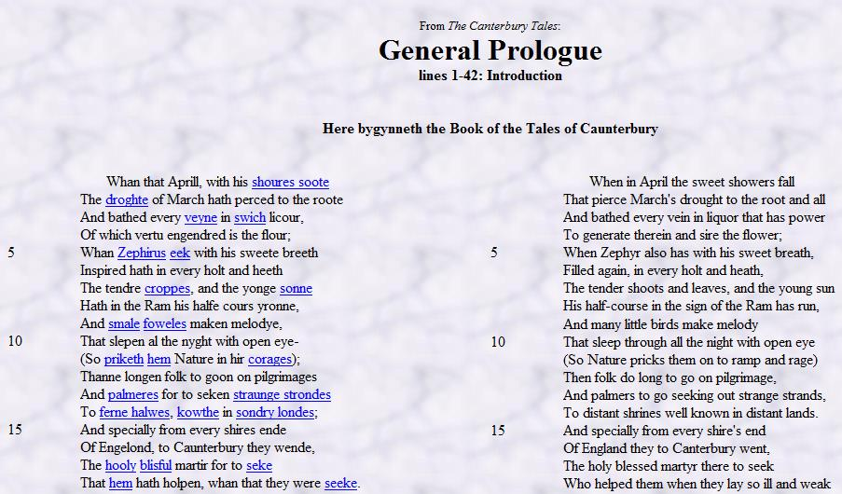
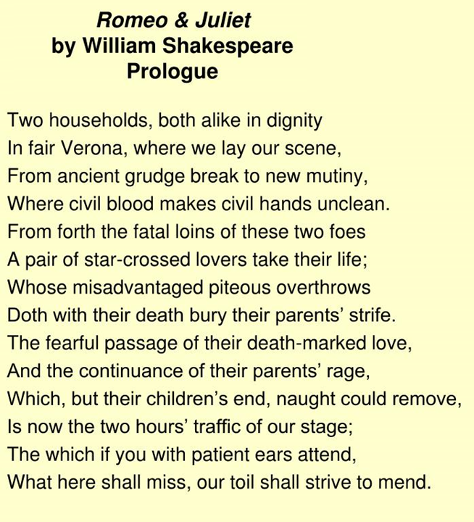
Early Modern
English
Old English
Modern English

Slide 16
Why is Shakespeare so Hard to read?
2. The Topics. There are ideas, items, and words in sonnets and plays that are unknown to most modern readers unless they have spent time reading about that time or reading essays about his work. Also, the time period setting makes it difficult. So sometimes when Shakespeare tells a joke, it falls flat (to you) because you weren’t around when it was “all the rage”. You dig?
Think about watching a movie from the 90s. Do you miss some of the inside jokes and references? Now take it back to like 400 years ago…
For example: Mirth. We really don’t use this word any more.
In MND: “Stir up the Athenian youth to merriments;
Awake the pert and nimble spirit of mirth;”

Slide 17
Why is Shakespeare so hard to read?
3. Speaking of language, Shakespeare’s sarcasm makes very sober statements about politics and societal standards.
He wasn’t just trying to entertain people; he wanted to critique the society he lived in.

Slide 18
Why is Shakespeare so hard to read?
Because he wrote about what was relevant to him and his time period, we can get an inside look to what life was like during that time.

Slide 19
How can I get better at reading Shakespeare?
There are a number of things you can do:
Read Shakespeare plays
Watch Shakespeare plays/movie adaptations
Use a side-by-side translation guide (but know you will be expected to do this without a guide on quizzes/tests)
Read literature about Shakespearean work

Slide 20
How can I get better at reading Shakespeare?
In class, we will be working on these three things to “UNLOCK” good ol’ Willy:
Vocabulary (words used during his time)
Language (construction of sentences)
Meter (the art behind the work)
By reviewing these three things, reading Shakespeare will not only be easier, but also more enjoyable and maybe you’ll finally get the jokes.

Slide 21
Vocab
Again, Early Modern English here.
My expectation: You do not have to know the vocab for the time period.
Will you have to know words like exuberant? Yes. Because we use that word today.
Will you have to memorize thee, wench, art, etc.? No. The book provides you with some explanations in the margins. Thought it is helpful to get familiar with them
This means I’ll give you the vocab word meaning, but you are still responsible for understanding what is being conveyed.

Slide 22
Language
By language, I mean, how Shakespeare talks.
We’ll spend a good bit of time dissecting why it’s harder to read his sentences than ours (MORE Grammar!!! Yay!).
We’ll also look at how the language appears on the page and how to read his work properly (not stopping at the end of a line)

Slide 23
Meter
Remember this word?
We’ll go into lots of details about how musicality in writing has a huge role in Shakespeare’s work.
No…Shakespeare people didn’t talk like this.
Yes, you’ll be writing your own sonnet and trying your hand at meter. ☺

Slide 24
Why are we reading Shakespeare?
Admittedly Biased: Yes, I do enjoy Shakespeare, and no, its not just because I’m an English teacher.
I believe reading Shakespeare is important because:
Themes- He touches on ideas that are universal and timeless and expresses them in such innovative and profound ways

Slide 25
Why are we reading Shakespeare?
I believe reading Shakespeare is important because:
Stories- If you modernized the language, and you altered some of the props (guns for swords, etc.) you get an action-packed, thought-provoking, and interesting STORY that tells a story we all can relate to- a human experience.

Slide 26
Why are we reading Shakespeare?
I believe reading Shakespeare is important because:
Language- Learning how to read Shakespeare is helpful as not everyone talks and conveys meaning in the same way. Understanding the grammatical structure, figurative language, and creative descriptions allow us to connect to people across time, space, and generations.
Movie Link: 3.5 minutes https://www.youtube.com/watch?v=nIZ_eq0vLfc

Slide 27
How is Shakespeare still relevant today?
1. You quote Shakespeare on a regular basis and don’t even know it.
Shakespeare’s influence on the English language runs deep. For instance, if you search the Oxford English Dictionary (OED) — the definitive record of the English language — Shakespeare is often identified as the sole user or first user of a word or phrase, according to Charlotte Brewer who authored the guide’s chapter on “Shakespeare and the OED.”
If you have ever said “It’s Greek to me,” suffered from “green-eyed jealousy,” “stood on ceremony,” been “tongue-tied,” “hoodwinked” or “in a pickle,” you are quoting Shakespeare.

Slide 28
How is Shakespeare still relevant today?
2. The Bard’s reach is cosmic.
The planet Uranus has 27 moons, the majority of which are named for Shakespearean characters
Titania, Oberon, Puck (A Midsummer Night’s Dream);
Juliet, Mab (Romeo and Juliet)
Etc.

Slide 29
How is Shakespeare still relevant today?
3. Some people don’t believe Shakespeare wrote the plays and poems that bear his name.
What cements a writer’s legacy more than when a segment of his or her audience contests their work? The great Shakespeare authorship controversy was sparked in the 1850s — more than 200 years after his death — when American writer Delia Bacon and British bookseller William Henry Smith each published their arguments on the topic.
Among other potential authors of the plays credited to Shakespeare, they suggested philosopher Francis Bacon and poet Walter Raleigh were more likely the “real” writers of Romeo and Juliet, etc. In the subsequent century, more than 50 alternative writers were proposed.

Slide 30
How is Shakespeare still relevant today?
4. Shakespeare has been a profitable brand for hundreds of years.
In 1710, publisher Jacob Tonson started a trend when he adopted Shakespeare’s likeness as his corporate logo, using the Bard’s portrait on his bookshop sign, in advertisements and on the editions of Shakespeare’s works that he published.
In the past four centuries, Shakespeare’s strength as a brand has not faltered. In fact, it’s ubiquitous. His likeness and his works have been used to sell soap, chocolate, cigarettes, computers, beer, soda and almost anything else you can think of.

Slide 31
How is Shakespeare still relevant today?
5. His likeness remains a mystery.
Although Shakespeare’s image has been reproduced time and again, we don’t actually know what he looks like. None of the printed portraits that accompanied his work date back to his lifetime.
The image that most people are familiar with is an engraving by Martin Droeshout, which debuted in 1623 on the title page of the first edition of Shakespeare’s collected plays called the First Folio.

Slide 32
How is Shakespeare still relevant today?
6. His works are universal and enduring, as are his characters.
Shakespeare’s works are emotional, hilarious, pithy. But above all, he was masterful at imbuing his stories and his characters with qualities that audiences and readers identify with — Hamlet’s anguish, Ophelia’s distress, the enduring love between Romeo and Juliet.
In Samuel Johnson’s preface to The Plays of Shakespeare (1765), he wrote, “His characters … are the genuine progeny of common humanity, such as the world will always supply, and observation will always find.”

Slide 33
Sources
https://news.usc.edu/91717/six-reasons-shakespeare-remains-relevant-400-years-after-his-death/

