Slide 1
Unlocking Shakespeare: Vocabulary
Speaking Like Shakespeare

Slide 2
Today’s
Focus Questions
Goals
How can my writing sound like Shakespeare?
How can writing like Shakespeare help me understand Shakespeare?
How do I understand Shakespeare’s vocabulary?
To review SVO
To examine commonly used words in Shakespeare’s time
To demystify words
To write like Shakespeare

Slide 3
Assignment
Guided Notes
Cheat Sheet Handouts
Playing with words

Slide 4
Shakespeare’s Language
Again, 3 things to unlock Shakespeare:
Language, Vocabulary, and Meter.
Language= standard and nonstandard syntax
What makes Shakespeare’s language confusing:
Using non standard syntax (Confusing this is not.)
Splitting verbs ( I will surely like my new coat.)
“misplacing” phrases (to the store, I will go.)

Slide 5
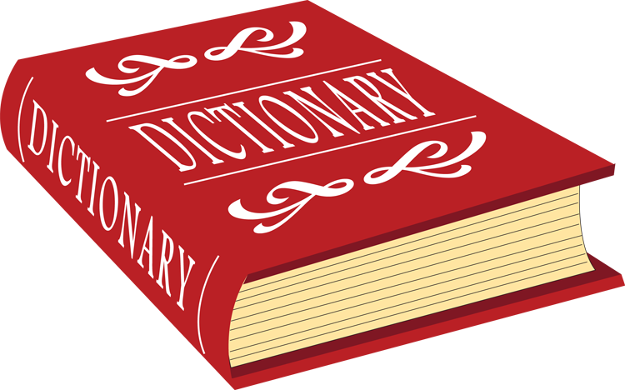
Shakespeare’s Vocabulary
One of the primary obstacles between Shakespeare’s plays and modern audiences is his vocabulary.
When he was writing, English was on the cusp of becoming Modern English and leaving Middle English behind.
There were no dictionaries, grammar texts were not produced until 1700, and Shakespeare had the equivalent of a high school education.
What Shakespeare did with language is amazing, but we have to understand where it comes from to make sense of it.

Slide 6
ERA | ~Time Period | EXAMPLE: The Lord’s Prayer
Old English | 450–1066 | Fæder ure þu þe eart on heofonum; Si þin nama gehalgod to becume þin rice gewurþe ðin willa on eorðan swa swa on heofonum.
Middle English | 1066–1450 | Oure fadir that art in heuenes, halewid be thi name; thi kyndoom come to; be thi wille don in erthe as in heuene.
Early Modern English | 1450–1690 | Our father which art in heauen, hallowed be thy name. Thy kingdome come. Thy will be done, in earth, as it is in heauen.
Modern English | 1690–Present | Our Father, who art in heaven, Hallowed be thy Name. Thy kingdom come. Thy will be done, On earth as it is in heaven.

Slide 7
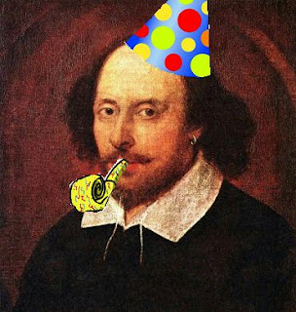
Shakespeare’s Vocabulary
Because of two bodies of literature – Shakespeare’s works and the King James Bible, newly translated in 1605 – this moment in English’s development was captured in time, and is thus referred to as Elizabethan English, after Queen Elizabeth I.
Why not Jacobean English, after King James I?
I have no idea. However, with practice, insight, and these awesome handouts, this obstacle can easily be minimized.

Slide 8
Shakespeare’s Vocabulary
How Shakespeare’s Vocabulary makes it difficult to understand and outline of what we’re covering today:
Figurative Language
Allusions
Contractions
Thee and Thou
Conjugation of verbs
Archaic words-no longer used in Modern English
Archaic meanings-Modern English words with different meaning then

Slide 9
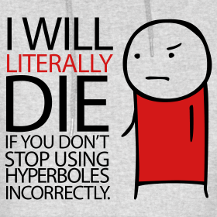
Figurative Language
The Cheat Sheet is a guide to help you so that if you come across something unfamiliar, you may be able to determine what Shakespeare is doing.
Figurative Language adds another layer of understanding to the text.
Act 1, scene 4, when Romeo says that love "pricks like thorn." RJ
“Your eyes are lode-stars and your tongue's sweet air...” MND Act 1 Scene 1

Slide 10
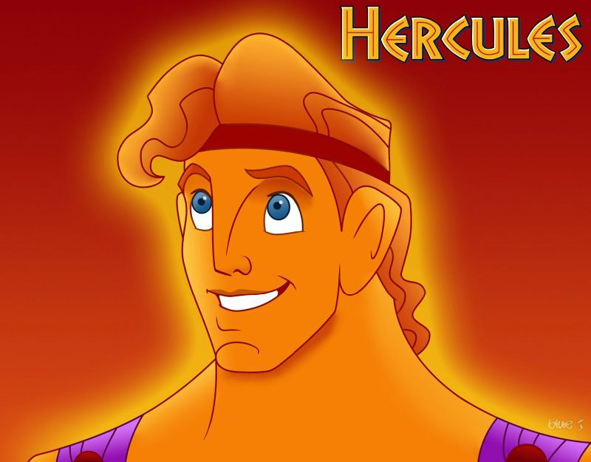
Allusions
Shakespeare skillfully used concrete language to enliven his writing.
Concrete language presents a picture to the mind.
Abstract language, on the other hand, does not.
An example of an abstract word is strength; an example of a concrete word is Hercules.
One cannot picture strength, but one can picture someone or something that has strength.
Allusions and direct references both
enable audiences and readers to
picture what Shakespeare is talking about.
This Photo by Unknown Author is licensed under CC BY-NC-ND

Slide 11
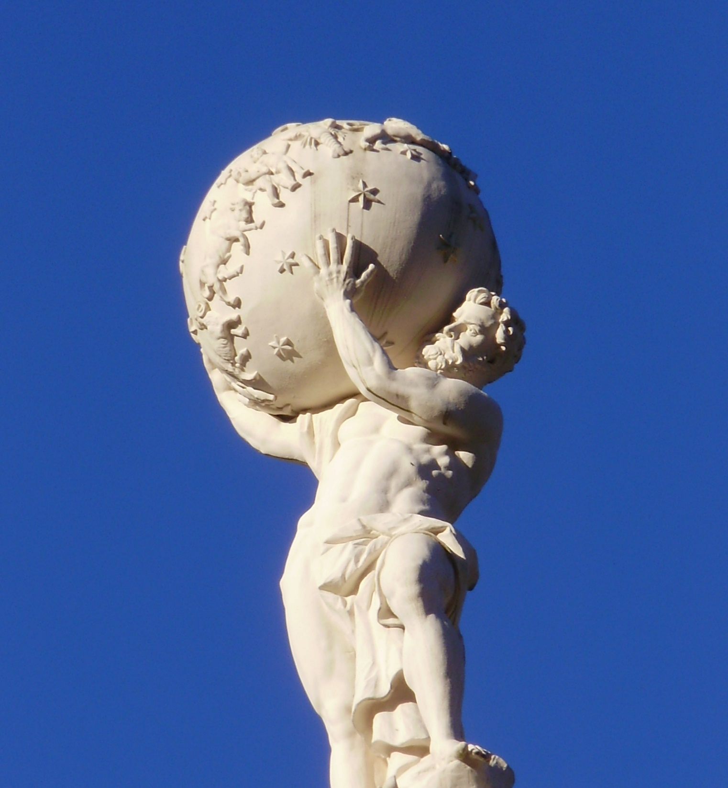
Allusions
An allusion is a figure of speech in which something infers to something else.
It is an indirect reference to a person, a place, a thing, or an idea in mythology, literature, history, or everyday life.
Think of it as a “linking” device.
For example, if the leader of a country faced a difficult decision that would affect the lives of millions, he might say, “I carry the weight of the world on my shoulders.”
His statement would be an indirect reference, or allusion, to the task of the Greek god Atlas, who bore the sky on his shoulders. (Sculptors and painters often depict Atlas as bearing the world.)
This Photo by Unknown Author is licensed under CC BY-NC-ND

Slide 12
Allusions
You have two ways to figure out an allusion that you don’t understand: context and research.
Context you look at what’s happening and determine how it function.
Research can include looking at the footnotes, asking a teacher, or looking up the answer online.
Literary allusions come from literature, novels, and stories.
Whenever you reference Romeo and Juliet, you’re making an allusion!
Biblical allusions come from Bible stories, people in the Bible.
If you’ve seen anything about an apple (Snow White anyone?) or about a serpent then it is referring to the story of Adam and eve.
Mythological allusions come from mythology, Greek or Roman or other. Do you know Hercules? Do you know Moana? Theses are stories from myths.
This Photo by Unknown Author is licensed under CC BY-NC-ND

Slide 13
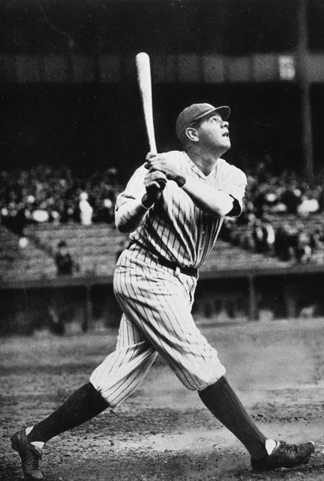
Direct Reference
A direct reference, on the other hand, is a specific mention of a person, a place, a thing, or an idea in mythology, literature, history, or everyday life.
For example, a television baseball announcer might say, “This batter has the potential to become another Babe Ruth.”
Ruth (1895-1948) was the greatest hitter in baseball when he played for the New York Yankees in the 1920s and 1930s.
In another example, an art critic might write, “This painter's bold innovations remind me of the ones Dalí made.” Salvador Dalí (1904-1989) was famous for his striking surrealist paintings.
This Photo by Unknown Author is licensed under CC BY-SA

Slide 14
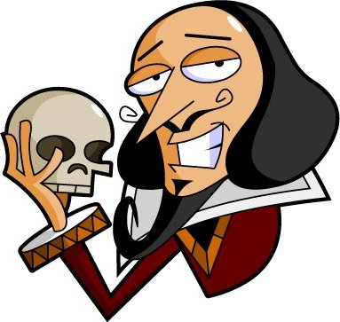
Direct Reference
Shakespeare frequently used allusions and direct references.
This practice enabled him to enrich his dialogue and descriptions with concrete images that helped audiences to understand his meaning.
A lengthy explanation became unnecessary.
At times, an allusion or direct reference may be obscure.
In such a case, the modern reader must use a dictionary, an encyclopedia, or an annotated copy of the play or poem to gain a full understanding of a passage.
But, in doing so, the reader develops a deeper appreciation of Shakespeare's verbal skill and the beauty of his language.

Slide 15
Example:
An allusion is an indirect reference to a person, a place, a thing, or an idea in mythology, literature, history, or everyday life. For example, if the leader of a country faced a difficult decision that would affect the lives of millions, he might say, “I carry the weight of the world on my shoulders.” His statement would be an indirect reference, or allusion, to the task of the Greek god Atlas, who bore the sky on his shoulders. (Sculptors and painters often depict Atlas as bearing the world.) Here is another example. Suppose an army general told a subordinate, “Your plan has about as much chance of succeeding as attacking Russia in the winter.” His statement would be an allusion to two of military history's most famous failures: Napoleon's invasion of Russia in 1812 and Hitler's invasion in 1941 of the same country (then known as the Soviet Union). Both campaigns ended in disaster for the invaders because neither Napoleon's French armies nor Hitler's German armies could cope with the brutal Russian winter. Both allusions enable audiences and readers to "see" what Shakespeare is referring to: (1) carrying the weight of the world on the shoulders, and (2) a winter landscape.
The eastern gate, all fiery-red,
Opening on Neptune with fair blessed beams,
Turns into yellow gold his salt green streams. (A Midsummer Night's Dream, 3.2.413-415)
Eastern Gate: Allusion to the sun.
Neptune: Direct reference to Neptune,the Roman name for the Greek god of the sea, Poseidon, in ancient mythology.

Slide 16
Contractions
This Photo by Unknown Author is licensed under CC BY-NC

Slide 17
The Same; just shortened
Translate the following:
"Been to class yet?"
"No. Heard the teach’ givin’ a freakin’ test."
"Wha'sup wi'that?“
What’s going on here? What is ’ mean??

Slide 18
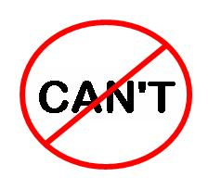
The Same; just shortened
Contractions- Since the word contract means to squeeze together, it seems only logical that a contraction is two words made shorter by placing an apostrophe where letters have been omitted.
I'm: I am
Can't: can not
We've: we have
Isn’t: Is not
This Photo by Unknown Author is licensed under CC BY-NC-ND

Slide 19
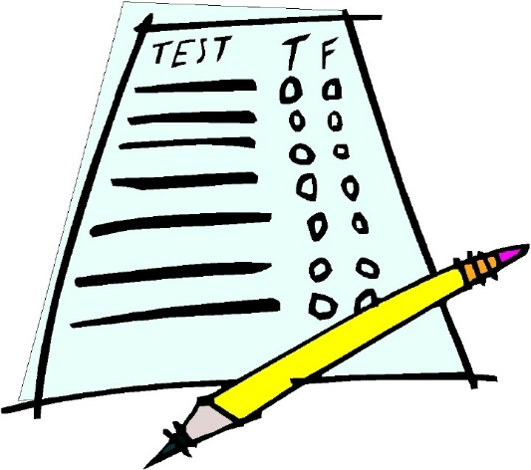
The Same; just shortened
We leave out words and parts of words to speed up our speech. If we were speaking in complete sentences, we would say:
"Have you been to class yet?"
"No, I have not been to class. I heard that the teacher is giving another test today."
"What is up with that?"

Slide 20
The Same; Just shortened
Technically speaking, contractions aren't necessary in written English.
Using the full version of a word is always grammatically correct.
However, there are a number of reasons why contractions do serve a valuable stylistic purpose.

Slide 21
The Same; just shortened
People may use contractions because:
Contractions make your writing seem friendly and accessible. They give the appearance that you are actually "talking" to your reader.
When writing dialogue in a novel or play, contractions help reflect how a character actually speaks.
Contractions help to save space when preparing advertisements, slogans, and other written works that must be short and to the point.
When trying to rhyme or fit the meter of a line of poetry, can’t will rhyme with slant but cannot does not.

Slide 22
The Same; Just shortened
This isn’t a new invention! Shakespeare used contractions all the time, especially to keep his meter (more on this later!)
On the following slides, you will see some different types of contractions that Shakespeare uses.
He follows the same guidelines as we do today: Shorten the words and in the omitted space put an apostrophe.

Slide 23
Shakespeare’s Vocabulary
wi’ = with
I’ = In
o’ = of
t’ = to
‘t = it
‘tis = it is
‘twas = it was
Oft= often
Ope=open
e'en = even (sounds like een)
e'er = ever (sounds like air)
ne’er = never (sounds like nair)
O’er= over (sounds like ore)

Slide 24
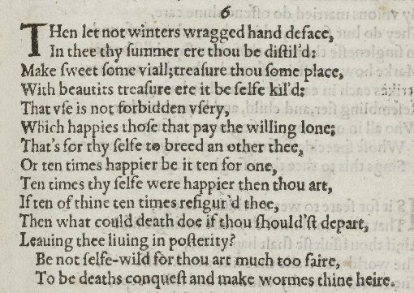
This Photo by Unknown Author is licensed under CC BY-NC-ND
This Photo by Unknown Author is licensed under CC BY-SA

Slide 25
Hey, you!
Fear not thees and thous! They both mean you, and they follow a pattern; just like Modern English.
Remember? I, me, my, mine?
Well here are some pronouns for you to know!

Slide 26
Hey, you!
Thou
Case: Nominative. Example: Thou art my friend.
When Used: To address a person of inferior status, such as a child or servant; to address a friend; to impart a poetic ring when expressing profound thoughts or reciting a prayer.

Slide 27
Hey, you!
Thee
Case: Objective. Example: I love thee. I give thee all my love.
When Used: To address a person of inferior status, such as a child or servant; to address a friend; to impart a poetic ring when expressing profound thoughts or reciting a prayer.

Slide 28
Hey, you!
Thy
Case: Possessive. Example: Here is thy sword.
When Used: To address a person of inferior status, such as a child or servant; to address a friend; to impart a poetic ring when expressing profound thoughts or reciting a prayer. Thy is not used before words beginning with a vowel or before words beginning with a silent h followed by a vowel. Instead, thine is used.

Slide 29
Hey, you!
Thine
Case: Possessive. Examples: This sword is thine. Where is thine enemy?
When Used: To show possession without a following noun or with a following noun beginning with a vowel or a silent h followed by a vowel.

Slide 30
Hey, you!
Thyself
Case: Reflexive or intensive. Examples: Wash thyself. Thou thyself art a fool.
When Used: To address a person of inferior status, such as a child or servant; to address a friend; to impart a poetic ring when expressing profound thoughts or reciting a prayer.

Slide 31
Hey, you!
Ye (Early Use)
Case: Nominative. Example. Ye are mighty lords.
When Used: To address several persons of exalted social position(s).

Slide 32
Hey, you!
Ye (Later Use)
Case: Nominative or objective. Examples: Ye are a fool. Ye are all fools. I'll strike ye down.
When Used: To address one or several persons of any social status.

Slide 33
Hey, you!
Ye as a Definite Article (Early Use)
Pronunciation: Same as the. Part of Speech: Definite article; adjective. Examples: Ye olde tavern (pronounced as the old tavern); Ye gods (pronounced as the gods). When Used: To modify a noun in the same way as the definite article the. Y was a printer's character representing th. Shakespeare generally did not use "ye" in this sense. Verb Endings: Not affected.

Slide 34
Shakespeare’s Vocabulary
Hast - Have [What hast thou done?]
Dost - Do [Why dost thou hate me?]
Doth - Does [Methinks the lady doth protest too much.]
Art - Are [Where art thou?]
Hence - Away from this place [I go hence.]
Henceforth/Henceforward - From now on [Henceforth, my son is king.]
Thence - From there, from that place [I come from thence.]
Whence - Which place, what place, what source/origin [Go back to the pit from whence you came.]
Whencesoever - From whatever place [Sent from London whencesoever.]
Hither - Here/to this place [Come hither!]
Hitherto - Up till now [I have escorted you hitherto.]
Hitherward - To here/this place [They move hitherward.]
Thither - To that place [She has sent me thither.]
Thitherward - In that direction [He was seen thitherward.]
Whither - To which place/why, for which purpose [Whither goest thou?] [Whither wouldst thou send for me?]
Somewhither - Somewhere [I go somewhither.]
Begone - Disappear, leave [Begone, villain!]

Slide 35
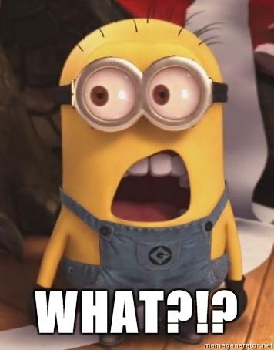
Sayest thou what?!
Conjugating verbs in Modern English is relatively easy, mainly because we changed two of the conjugations.
To conjugate in Elizabethan English,
2nd Person singular verb adds -est, (you give is thou givest)
3rd Person singular verb adds –eth (she gives is she giveth)
This Photo by Unknown Author is licensed under CC BY-NC-ND

Slide 36
Sayest thou what?!
Verb conjugation also follows a pattern. It’s just a little more complicated than English verb conjugation is now. Let’s compare verb conjugations in Spanish, Modern English, and Elizabethan English.

Slide 37
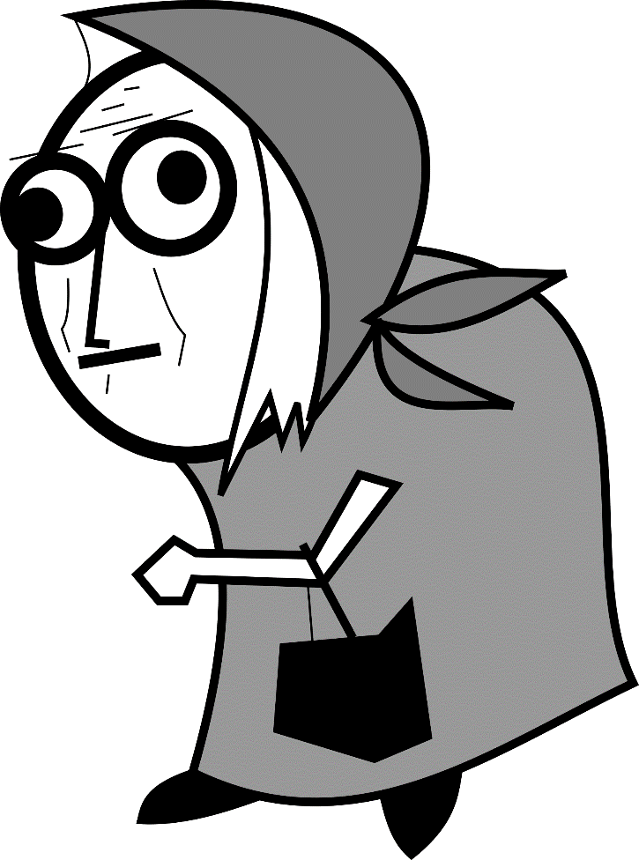
Archaic Words

Slide 38
Archaic Words
Most of us run into problems when we come across archaic words that are no longer used in Modern English.
Or worse, when we run across words that are still used today but have much different meanings than when Shakespeare used (or invented!) the words.
This is particularly troublesome, because we think we know what the word means, but the line still doesn't make sense.
Although it is frustrating when we come across these unknown words, it is not surprising.
Shakespeare's vocabulary included 30,000 words. Today our vocabularies only run between 6,000 and 15,000 words!
Because Shakespeare loved to play with words, he also created new words that we still use today.

Slide 39
Shakespeare’s Vocabulary
Words we use today | Words no longer used
Bandit | Aye- always
Bump | Colours- battle flags
Majestic | Hap-chance
gossip | Morrow-morning
swag | Sith- since
monumental | Swain-a young man/lover
courtship | Wot- know
Cold-blooded | Withal-as well
Elbow | Slugabed- someone who sleeps in
worthless | Ye- you (all)

Slide 40
Archaic meaning
Some of Shakespeare’s words had meanings that no longer exist today.
that is, we might still use the word, but not in the same context!
Meaning changes over time depending on usage.
For example: Dab. We use it as a verb meaning a particular kind of gesture (He dabbed after scoring a touchdown); however, the word means a spot or splatter or small portion of something (He dabbed the paint onto the canvas).

Slide 41
Archaic meaning
Bedroom- Although your bedroom might be the room you have your bed in, Shakespeare’s was literally the room you have in bed between people.
“Then by your side no bed-room me deny,” he states, “For lying so, Hermia, I do not lie.”
Moonshine- Yes, we know this as alcohol, but Shakespeare meant it in the same way as sunshine- the light produced from the moon.

Slide 42
Archaic meaning
Housekeeper- We mean someone who keeps the house in order, but Shakespeare in Macbeth means someone who keeps up with the house or in this case, watches and guards it.
Anatomy- In Romeo and Juliet, the word is referring to a dead body. HOWEVER, in The Comedy of Errors, he uses to refer to a person who is emaciated, or super skinny. Either way, we use it today to describe the structure of the body
Proficient- We use this word as an adjective, but Shakespeare used it as a noun, meaning an extremely skilled person.
“I am so good a proficient in one quarter of an hour that I can drink with any tinker in his own language.”

Slide 43
REMEMBER-
I won’t expect you know these kinds of words.
There will ALWAYS be a glossary on quizzes/tests that ask you to translate with archaic word or archaic meaning.
My hope is that you will “get used to” seeing thou and thee that you won’t have to go back to your handbook every time.
However, use today’s notes and handouts as much as you need to assist you.
Need more help? Check out my website under Unit 3, Resources for Shakespeare

Slide 44
Assignment:
Use the glossary on the next to last page to translate Elizabethan English into Modern English
Then translate the Modern English into Elizabethan English.
Have fun!

Slide 45
Extra words that got cut-off in the packet:
Post-Haste- with great speed or immediacy.
Yon=yonder= at some distance in the direction indicated (over there)
Wench- a young girl, child, or servant. Over time the word came to mean a prostitute. Although typically is used to describe women, if used to describe a man, it would indicate someone who spends time with a prostitute. It is most commonly viewed as an insult, regardless of gender.
Wroth-anger

Slide 46
Sources
http://shakespearestudyguide.com/Shake2/Allusions.html

