Slide 1
From Script to Stage (ENG1)
Wednesday, Oct 3rd

Slide 2
Today’s Goals and focus Questions:
Finish yesterday’s asignment
Read a play
Create a comic of the plot
Observe the difference between script, play, and film
How is a play different from a short story?
How can we understand plot in a play?

Slide 3
“First Stop, Ellis Island”
Ellis Island, in Upper New York Bay, was the gateway for over 12 million immigrants to the U.S. as the United States' busiest immigrant inspection station for over 60 years[8] from 1892 until 1954.
Ellis Island was opened January 1, 1892. The island was greatly expanded with land reclamation between 1892 and 1934. Before that, the much smaller original island was the site of Fort Gibson and later a naval magazine. The island was made part of the Statue of Liberty National Monument in 1965 and has hosted a museum of immigration since 1990.
It was long considered part of New York, but a 1998 United States Supreme Court decision found that most of the island is in New Jersey.[9] The south side of the island, home to the Ellis Island Immigrant Hospital, is closed to the general public and the object of restoration efforts spearheaded by Save Ellis Island.

Slide 4
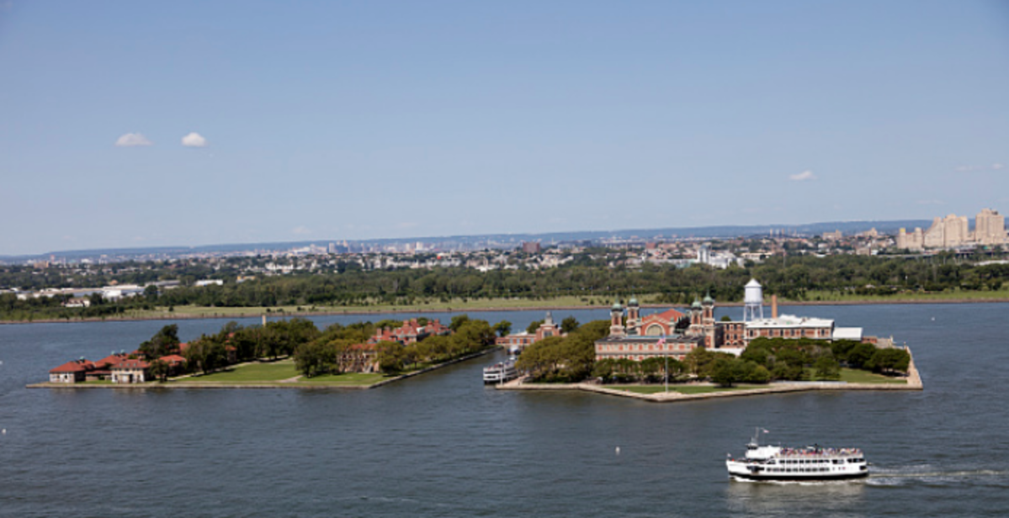

Slide 5
Let’s Read!

Slide 6
Let’s Analyze
Complete the worksheet by looking at the story and providing examples from the play in the appropriate boxes.
Example:
Play: “First Stop, Ellis Island”

Slide 7
What happened?
Sometimes reading plays, we get confused by dialogue or stage directions.
But there’s still a plot!
Your job is to figure out what is happening in this short play.
Then you are to design a 6 panel comic that demonstrates the plot.
Hint: There are only 6 panels, so there may be some things you will have to leave out.

Slide 8
Example:

Slide 9
Assignment:
1. Finish the Analysis Worksheet from yesterday
2. Make a comic of the PLOT that is happening in “First Stop, Ellis Island”
Be sure to include scenes from all parts of the play
Be sure to include color (outlines, shading, etc.)
EXPLAIN what is happening in each of your scenes. You will not be graded on your artistic abilities, but on your understanding of the play. If I can’t tell what you drew, that’s why there’s an explanation box.

Slide 10
From Script to Stage
Wednesday, Oct 3rd

Slide 11
Today’s Goals and focus Questions:
Review the Stage directions
Create a “set”
Observe the difference between script, play, and film
How is a play different from a short story?
What is the difference between different viewings of the play?

Slide 12
Observe the opening lines of the play…
We get a long list of Stage directions.
That’s because this play only takes place in this setting
This is important for your characters.
As it is hard to imagine what that might look like, let’s recreate it!

Slide 13
Who: In groups of 4-6 people, or solo. No smaller, no greater.
What: 1. Create a set for “A Raisin in the Sun”
2. Write a rationale piece that includes text support to explain why they drew what where, and as to WHY they think the setting plays a huge role on these characters (or characters in general).
3. Display in room
Why: Imagining a scene as it plays out in a script can be difficult. By recreating the set, students may get a better understanding of where this story takes place, and why setting is so important to these characters. Providing a rationale will enable their teacher to understand their thought process (show your work!) and allow students to cite strong and thorough textual evidence (RL 9-10.1).
When: Today only, in class
Where: On large sheets of paper (8.5 x 11 for solo), and written response on notebook paper.
How/details: Students should use the stage directions at the beginning of Act 1, Scene i, in order to help them illustrate their stage set-up. In addition, when they write their rationale, they should use direct quotations with page numbers to indicate WHY they chose the room to look the way it does. Be sure to add color.
How Much: This is worth ~2 quiz grades (180 points)

Slide 14
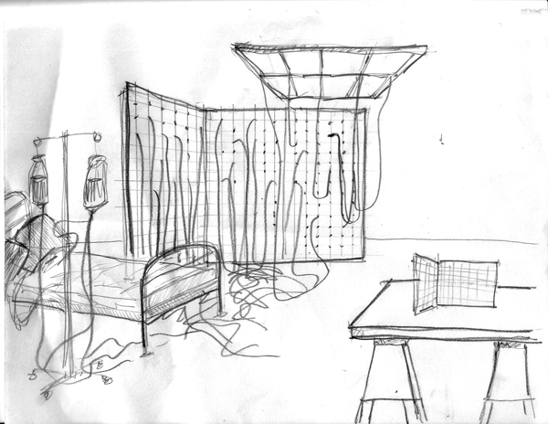
Example Stage set designs
Side view
Over view

Slide 15
Day 4 Plays

Slide 16
Today’s Goals and focus Questions:
Observe the difference between script and play (filmed production)
Analyze what is emphasized in each scene, and what is left absent.
How is a play different from a short story?
What is the difference between different formats of the play?

Slide 17
Plays are meant to be experienced…
It’s hard to imagine what is going on in the play, even with so many stage directions.
Visualization practices, like the one you did yesterday, are helpful, but it’s still not “play” quality.
To help us understand more about a play, we’re going to experience the play the only way we can in a classroom…
Film!
*We won’t be watching the whole play or reading the whole play. I decided we will tackle this in Unit 3 (if there’s time!). Hold onto your character charts for now. You won’t have to turn those in. Let’s just use this play to help us understand plays for this week. Tomorrow, we’ll tackle Flash Fiction.

Slide 18
Analyzing the same scene through multiple formats
You are to analyze how a script and a play production vary in their presentation of the same thing.
We will watch the play production first, and then you will go back, and in groups of no more than 4, analyze the text portion.
The text goes up to page 12 in the larger books, where Walter mumbles and stage directions: [His sister BENEATHA enters….]
Film Production: https://www.youtube.com/watch?v=XVl5A7YH_58
12:35

