Slide 1
Characterization
Direct and Indirect

Slide 2
Characterization
Characterization is the process by which the author reveals the personality of the character.
Two types of characterization:
Direct Characterization
Indirect Characterization

Slide 3
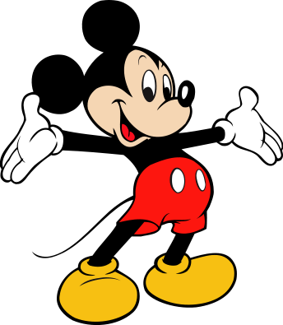
Direct Characterization
Direct characterization tells the audience what the personality of the character is.

Slide 4
Direct Characterization
“The patient boy and quiet girl were well mannered and never disobeyed their mother.”
Mickey Mouse is a handsome mouse who is very funny.
The author directly tells the personality
The boy is “patient”
The girl is “quiet”
Mickey is both “handsome” and “funny”.

Slide 5
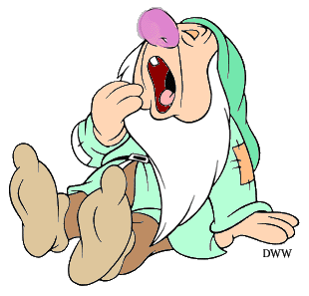
Indirect Characterization
Indirect Characterization shows things that reveal the personality of the character.

Slide 6
Indirect Characterization
There are five methods of indirect characterization (Steal):
Speech
Thoughts
Emotions/Effect on others
Actions
Looks

Slide 7
Indirect Characterization
Speech. What does the character say? How does the character speak?
Sarah said, “The world has a lot to offer someone; they just have to go out there and get it.”

Slide 8
Indirect: Speech
What someone says is important.
Think:
Do they say different things to different characters?
Do they tell the truth?
How do they speak to others?

Slide 9
Indirect Characterization
Thoughts. What is revealed through the character’s private thoughts or feelings?
He was thinking it was a bad idea, but there was no way he could tell his best friend no.

Slide 10
Indirect Characterization
Effect on others toward the character, and their own emotions.
What is revealed through the character’s effect on other people? How do other characters think and behave in reaction to the character?
Rachel had hurt Amanda’s feelings. How could Rachel start dating the guy Amanda had been flirting with for the past two months? Amanda began cry in heaping sobs.

Slide 11
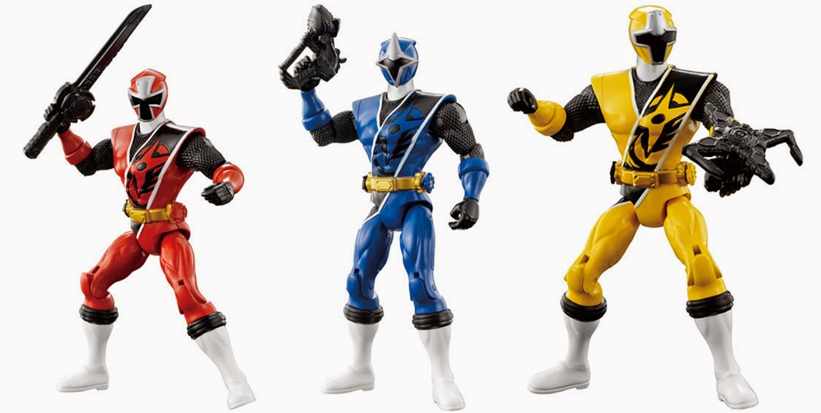
Indirect Characterization
Actions. What does the character do? How does the character behave?
He began to run. He didn’t know where he was going, nor did he care. He shouted profanity at the cops as he took off down the alleyway.

Slide 12
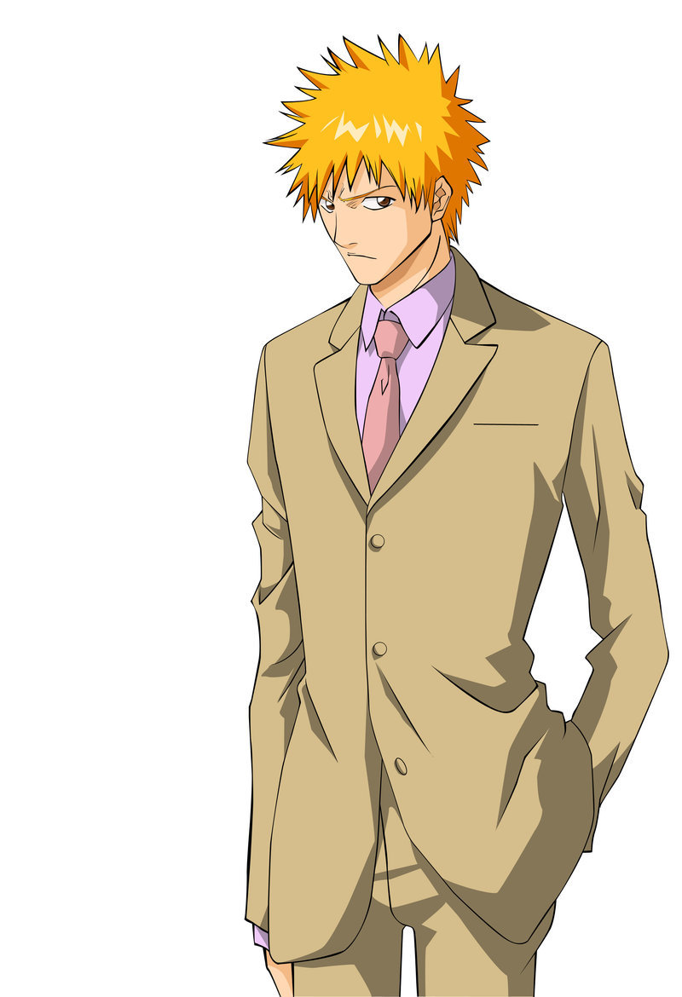
Indirect Characterization
Looks. What does the character look like? How does the character dress?
He was tall for his age.
His hair wast he color of a
fresh squeezed orange,
and he wore a tailored suit
to match the scowl on his
face.

Slide 13
How to Characterize
Look for Direct Characterization first. This is whenever the author or another character tells you something about that character; even if it is in quotes.
Be sure to gather anything you can that the author readily provides you- they want you to understand and empathize with their characters!

Slide 14
How to Characterize
Indirect Characterization is more difficult; look for clues where you have to infer information.
Whenever you read something and it makes you question the character, that is indirect characterization.
Use the STEAL method to help you.
Start with one letter, and review the pages you’ve read to see how the author implies information about the character.

