Slide 1
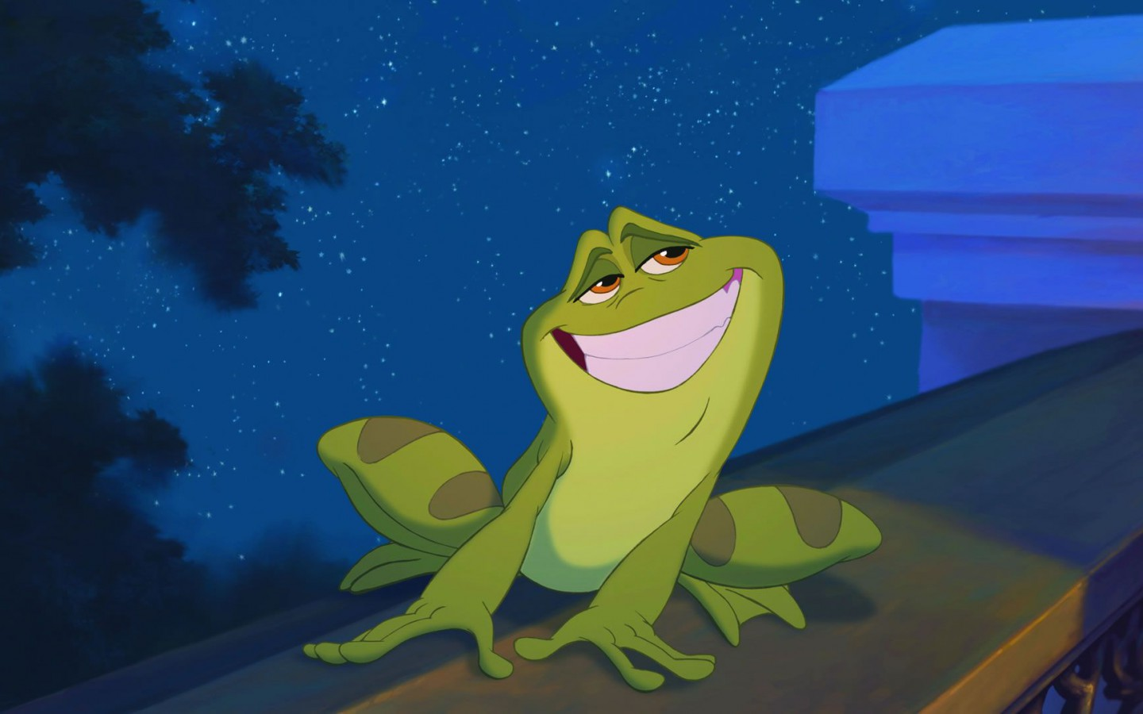
Welcome to English 4
Ms. Bugica

Slide 2
Today’s Goals/ I Can…
Analyze what makes a classroom work
Determine what is expected from me as a student in Ms. B.’s class
Identify student resources in the classroom
Discuss Overview worksheet and state standards
Today’s Focus Question:
What makes a good class?
What do I need to know to be successful in this course?

Slide 3
The Good, the Bad, and the Ugly
Whether we like it or not, we’ve got the rest of the year together
That’s right, all of us will be here for the last leg of your journey in your high school career.
So before we “begin”, let’s think about some important things
Specifically, let’s recall all of our memories of our previous classes, in previous schools, and our previous teachers.

Slide 4
BellRinger: Think/Pair/Share
Each of you will have a worksheet.
You will get ~3 minutes to fill it out the best you can.
Be sure to complete the worksheet considering your experiences but WITHOUT naming the course (Biology), the department (Science), or the teacher (Ms. Rodoski).
Find a neighbor; someone within sitting distance. You may have a group of 3.
Discuss with your group your experiences (again, no particulars!)
After ~3 minutes, I will call on students to share as a class.

Slide 5
The BEST class….
The Worst class….
Teacher
Made learning fun by bringing the world to our classroom (guest speakers)
Teacher
Never explained WHY
Student
Working together, and actively paying attention
Student
Give up because x,y,z

Slide 6
The Power of Choice
One of the topics we will be covering this week is the power of choice.
Right now, day 1, we can choose how the rest of the semester will be.
You’re so close now, don’t give up!
Colleges can and will revoke your acceptance if they are not satisfied with your academic performance.
Current and future jobs can fire/refuse hire due to your grades.
"Don't let the fear of the time it will take to accomplish something stand in the way of your doing it. The time will pass anyway; we might just as well put that passing time to the best possible use.“
—Earl Nightingale

Slide 7
Activity 1: Introduction What questions do you have about me as your teacher, This course, this classroom, etc.

Slide 8
How do you say your last name? /Where are you from?

Slide 9
Why are you an English Teacher?
“Literature takes students out of their own lives and lets them experience things that are new and challenging, and encourages them to imagine possibilities and to think about ways the world could be different. Few textbooks could be said to do the same thing.” 1

Slide 10
Where did you go to school?
I am a North Carolina Teaching Fellow alumna
University of North Carolina at Chapel Hill
major in English and a minor in creative writing
Wake Forest University
Master's Degree in Education
Research project on exploring grammar through the
performing arts
Queens University of Charlotte
Master’s in Fine Arts in Creative Writing
Focus in poetry
Capstone project on the longevity and appreciation of the sonnet form

Slide 11
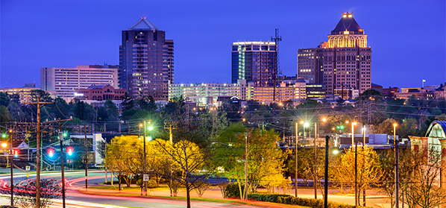
How long have you been teaching?
For the past 6 years I’ve lived and taught in Greensboro
I took last semester off from teaching to begin my writing career.
I am currently working towards publishing my work
I’ve just recently moved to Cary and I am excited to learn more about the area!
#
This Photo by Unknown Author is licensed under CC BY-NC

Slide 12
Nope! But I have a dog: Koda a frog: Remi 3 goldfish: Hibiki, Maru, Kiita Betta fish: Kephil
Do you have any kids?

Slide 13
What do you do outside of the classroom?
paint
ukulele
Hike
photography
French

Slide 14
Do you Host any clubs?
Previously I’ve coached both boys and girls soccer
I was also the head of the Cake Decorating Club, Young Adult Writer Club, and a Slam Poetry Club.
I currently do not host any clubs but would love to get student interested in creating a Slam Poetry chapter here. So if you’re interested in spitting truth, laying down knowledge, spreading the word, and performance, let me know!

Slide 15
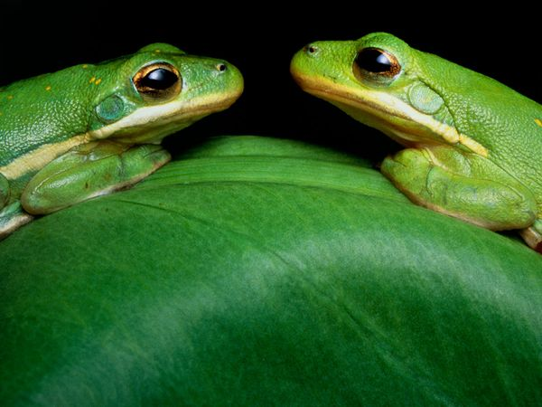
Uh… What’s in the tank?
No fear! We have a class pet!
Rémi is a Green Tree Frog
His diet consists of live crickets, so don’t be alarmed if you see some!
I feed them ~twice a week
They have a live-planted tank
Rémi sleeps during the day
Sometimes he makes croaking noises (sounds like a little dog)

Slide 16
What can we do with our classroom pet?
Do not tap on the glass
Do not try to make him move
Do not crowd the tank
Do not pour water or other liquids into the tank
Do not put things in the tank
Do not feed them
NEVER pick up frogs or touch anything in tank
Although not poisonous to humans, the frogs can get sick from the contaminants on your hands.
Any human who touches any amphibian or reptile should always wash their hand with soap and warm water before and after handling. This includes touching anything in our habitat.
ALSO… green tree frogs can jump 8-10 feet, and being only 2inches long, we don’t want him escaping!

Slide 17
What are the rules in this classroom?
RESPECT

Slide 18
What can we do to keep Ms. B. happy?
My biggest pet peeve…
GROOMING in the classroom.

Slide 19
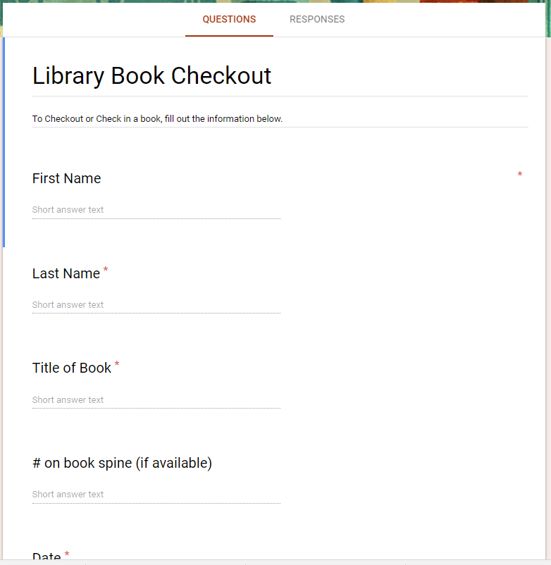
How do I check out a book from the bookshelf?
Seriously, they’ve all been donated or I’ve bought them with my own money
Remember which shelf you got them from- some of the books are arranged by genre!
If you want to take them out of the classroom, use your phone to take a picture of the QR code or go to the link to fill out information in the google form.
Don’t have a phone? Let your teacher know!
I have a lot of books!
Please treat them better than you treat your own books

Slide 20
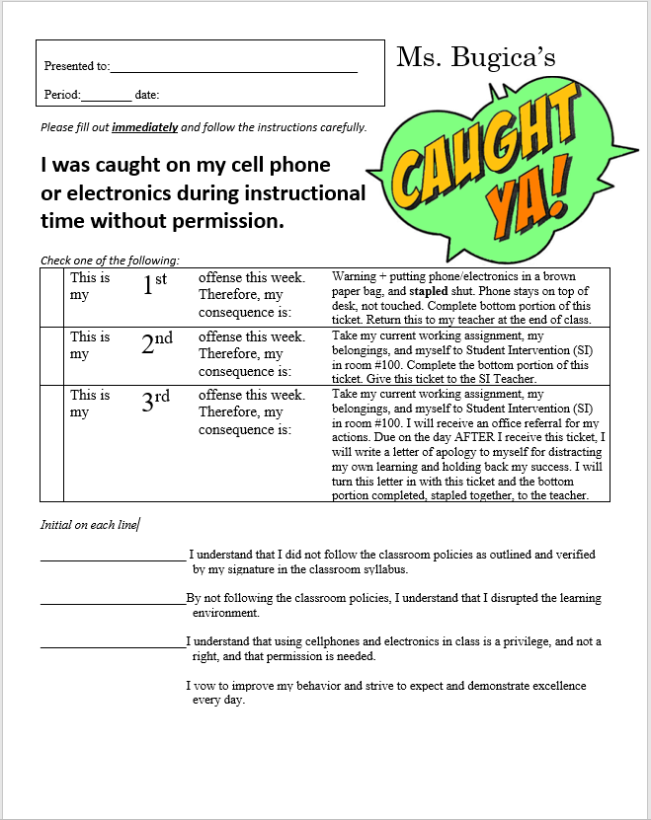
Can I use my phone in class?
Caught Ya! Slips
I get it, phones are important.
But you will not see me on my phone in class unless emergency
Your best friend broke a nail or your buddy’s snapchat is not an emergency
Checking every two seconds to see if there’s an emergency isn’t okay either
If you are caught on your phone WITHOUT PERMISSION, your phone is bagged.
2nd time, you leave class.
3rd time, leave class, office referral, & a letter of apology

Slide 21
What do I do when I need to go to the Restroom?
If you need to leave the classroom, it is not an emergency, and you won’t be interrupting the teacher or other students, then you DO NOT have to “ask” (in the traditional hand-raising)
Instead, go to the front of the room, place your phone in the cubby, and take a hall pass.
One student may go to the restroom at a time unless there is an emergency.
Upon your return, you may collect your phone.
As you are seniors and are steps away from the real world, I am not going to monitor or limit your RR habits. HOWEVER, should a problem arise, this policy is subject to change.

Slide 22
What are the grades like in this class?
"Our problem is that we make the mistake of comparing ourselves with other people. You are not inferior or superior to any human being. You don't determine your success by comparing yourself to others, rather you determine your success by comparing your accomplishments to your capabilities." -Zig Siglar
Grading Policy: Major Assessments= 65% Minor Assessments= 25% Practices and Processes= 10% | Grading Scale: A= 90-100 B= 80-89 C= 70-79 D= 60-69 F= below 60

Slide 23
How much homework/classwork do you give?
You are going to work hard in this class- I know you’re seniors and your steps away from the next great thing, BUT, life gets pretty real, really quick.
The work I assign I believe is important to you learning the skills needed (more on this later), and all work assigned is graded.
Students care about grades for: transcripts for colleges or for jobs
Teachers care about grades for: “evaluate” what you’re learning
Are grades the most important thing in this classroom?
Absolutely NOT!
Grades matter but learning matters more.
Grades are ONE way to numericize WHAT you are learning, but nothing is more important (to me) than the process of learning.

Slide 24
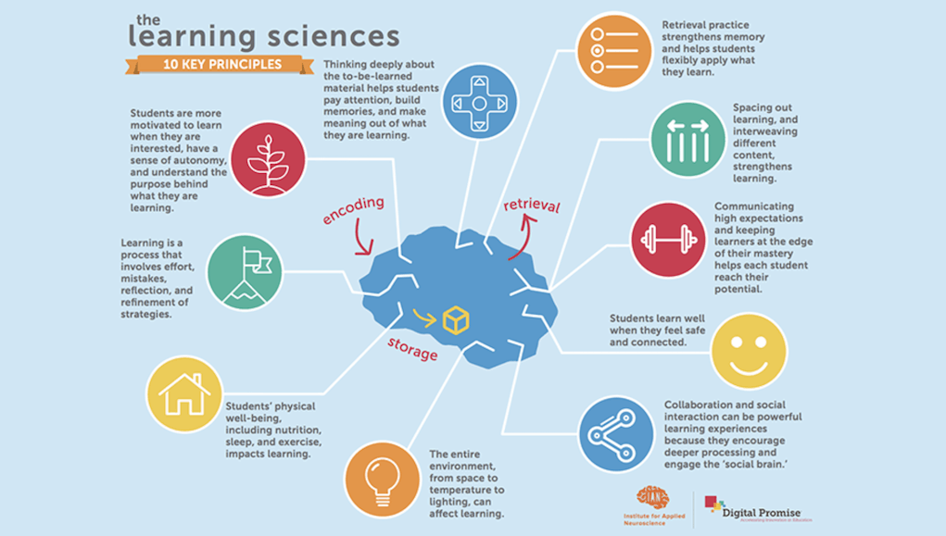
What is the learning process?

Slide 25
What are we going to learn in this class?

Slide 26
What kind of teacher are you?
I promise you that I will:
believe in your ability to succeed. This means my expectations are extremely high. I will demand your best at all times, but understand that we all make mistakes.
• listen to you. I ask that you bring questions, concerns or comments to me in a calm, respectful manner at the appropriate time.
• respect you and your ideas. You do not need to earn my respect.
• only assign meaningful work (just ask!). I do not believe in busy work. All my assignments will have purpose, and whenever possible, direct relation to the real world.
• persevere in the face of adversity. If I make a mistake, I will admit the error, and will work to rectifying the problem.
• establish equity over equality; that is, I will strive to give each of you what you need (fairness) to be successful over requiring you to “fit the mold”.
• acknowledge and celebrate the diversity in our classroom. I will learn from you. You are intelligent individuals and each of you brings experiences and perspectives to the class that will help us all grow.
• protect your right to learn and love school by following our classroom management plan as outlined in this syllabus every time a rule is broken.
• to make how we learn more important than what we learn; that is, I will focus on the skills that you will utilize later in life rather than the content that is constantly changing.

Slide 27
Why all the frogs?
Well, If you haven’t guessed yet, I like frogs.
It started out as a kind of joke, but as the years gone by, I’ve accumulated quite a collection
Most of the items are gifts from friends, parents, and past students. Some of them are ones I’ve purchased myself
And it keeps growing!

Slide 28
How do I get in contact with you?
Email:kbugica@wcpss.net
10 Building:Room 1012
http://bugk.weebly.com
Tutoring: Mondays A Lunch and Afterschool

Slide 29
How do I stay up to date in your class?

Slide 30
Activity 2: Overview and Standards What is a standard? Why is it important?

Slide 31
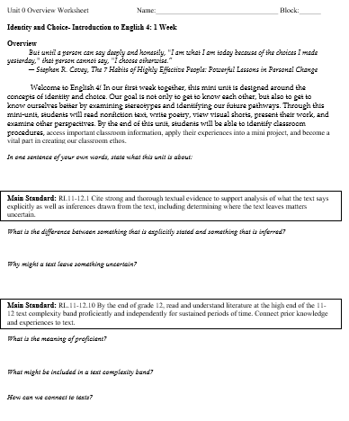
Unit Overview
For each unit, we will prepare ourselves with a unit overview worksheet.
This sheet allows us to get to know what we’re learning, how we’re learning it, and why.
Full disclosure/open book policy- You will know what I know when it comes to what is expected of you by the state.
We will have one of these for every unit.

Slide 32
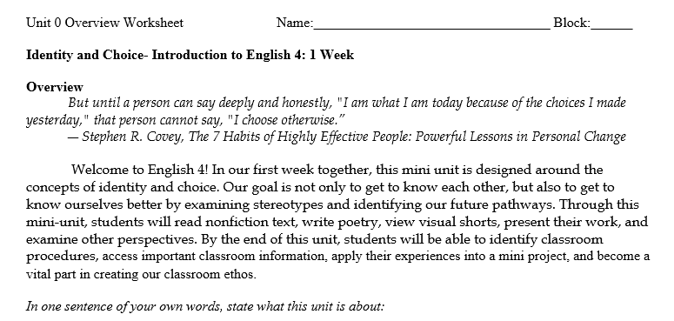
Title of worksheet/ unit number
Title of unit, longer title, length of unit
Quote that relates to Unit + explanation
Interactive Questions to get you thinking

Slide 33
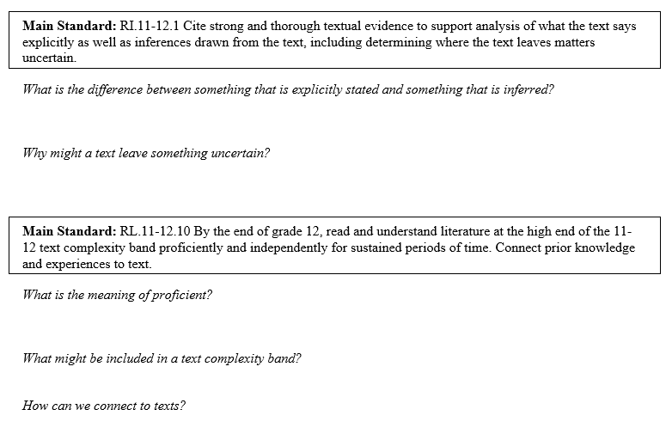
Main Standard we will focus on for the unit
Interactive Questions to get you thinking
There may be more than one main standard
Most units will cover many standards

Slide 34
What is a Standard?
Webster: a level of quality or attainment. ie a standard of living
The standards are set out by the state to “prepare all students for success in college, career, and life by the time they graduate from high school.” (Corestandards.org)
In our classroom, these standards are our guidelines in understanding what skills will be important to take with us once our high school career is over.
Although you will not have to memorize them, I want you to be able to understand what they are so I can help you understand the WHY to the WHAT we do in class.
They fall under different categories and have a unique labeling system.

Slide 35
Example Standard
Reading Literature (strand)
English Language Arts
Literacy
Grade level
Separate info
Number of standard
ELA-LITERACY.RL.11-12.1 Cite strong and thorough textual evidence to support analysis of what the text says explicitly as well as inferences drawn from the text, including determining where the text leaves matters uncertain.
Standard

Slide 36
But WHY!!!!!
These standards are skills.
Skills you will need for the rest of your lives.
PREACH: It’s not WHAT you’re learning, it’s HOW you’re learning.
So even though we will be focused on British Literature (WHAT) and that is important, know that you will be tested on the standards (HOW).
Example:
Read R+J.
Test question: What is the effect of Shakespeare’s transformation of Arthur Brooke’s poem The Tragicall Historye of Romeus and Iuliet?
Skill: examining how and why people alter things of the past and the impact of those changes
Real world: Voice-command: originally used as speech to text to eliminate the need for learning short-hand (a form of writing that allows for quick note taking). Today, we have in-home capabilities which allow people of different abilities to have more freedom in their own homes.

Slide 37
Main Standards
What is the difference between something that is explicitly stated and something that is inferred?
Why might a text leave something uncertain?
What is the meaning of proficient?
What might be included in a text complexity band?
How can we connect to texts?

Slide 38
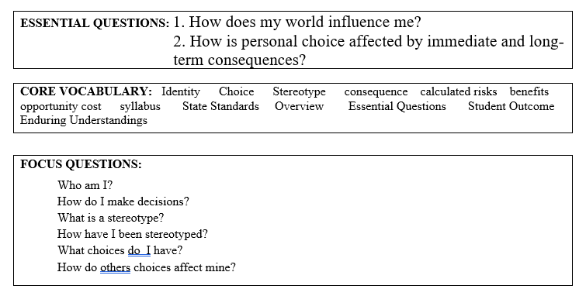
Essential Question- questions that cause genuine and relevant inquiry into the big ideas, provokes deep thought, requires consideration of alternatives, stimulate on-going rethinking, sparks meaningful connection with personal experiences, and naturally recurs.
Words important to understanding the unit
Questions that break down the essential questions into smaller, more accessible building blocks.

Slide 39
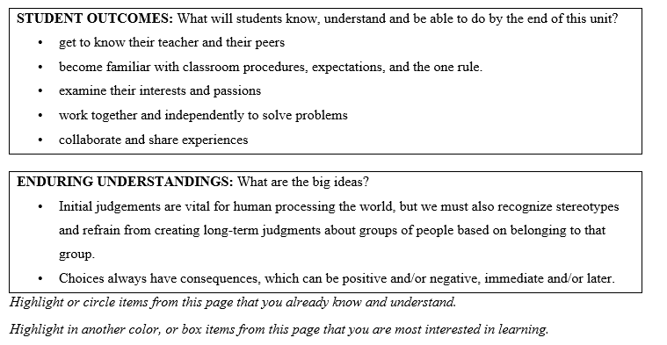
Student outcomes- what you will be able to do
Enduring understandings-
Big ideas you will expand upon
Your job on the back side- determine what information you know and what you will be learning.

Slide 40
Unit 0, Day 1
Mini unit

Slide 41
Enter: Think, Pair, Share
What are some of the factors that seem to play a role in shaping how you see yourself?

Slide 42
Video Clips
You will be watching a series of clips that examine issues related to Identity from the film, Off and Running.
Background: Avery is an African-American high school student who was adopted as an infant and is being raised in Brooklyn, New York by two white Jewish women. Her two brothers were also adopted. One is biracial and the other is Korean. In the film, Avery recently has tried to establish contact with her birth mother by sending her a letter.
Please respond to the questions on the handout as you watch the video.

Slide 43
Video Clips: (9:54)
https://www.youtube.com/watch?v=c17ciBT7L3s (2:57)
https://www.youtube.com/watch?v=lVxKKFQ8HOo (1:50)
https://www.youtube.com/watch?v=zG3FyRdXVsM (3:39)
https://www.youtube.com/watch?v=heS05fveVrY (1:28)

Slide 44
Answer and Discuss:
Finish the reflection questions on POV worksheet.
Who or what defines your identity?
How does the way you define yourself compare with the way that others define you? How does this affect your relationship with others?
Can identity change over time? Why or why not?

Slide 45
Exit Slip/ Homework
Complete the worksheet EXPAND
Focus questions:
Who Am I? Why Do I Matter?
How does your world Influence you?
Turn in both worksheets when finished

Slide 46
Sources
1. https://www.brighthubeducation.com/teaching-methods-tips/100744-the-importance-of-teaching-literature/

