Slide 1
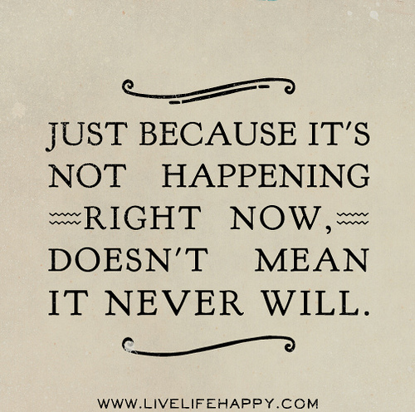
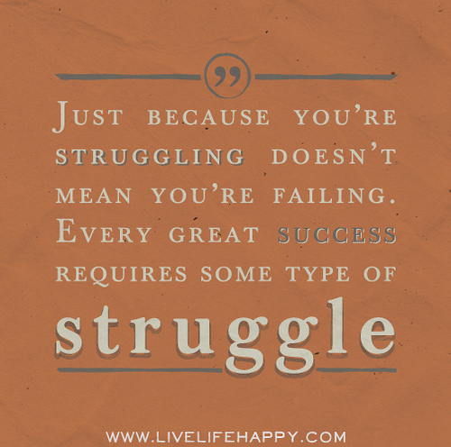
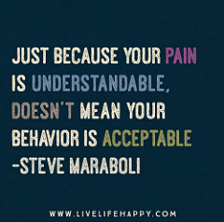
Just Because…
Week 1, Day 2
Turn in Syllabus if it’s signed, rip off last page

Slide 2
Enter- Brainstorm (you can make a list, a bubble chart, whatever works best for your learning style)
What are some of the things people think or say about others based on how someone looks, acts, or because that person is part of a certain group, especially the things that are not necessarily true?
Examples: “people think he’s a trouble-maker because he has a long hair” “people think she’s good at math because she’s Asian”
After you brainstorm at least 7 things, see if you can group them into categories (example: Appearance, Race)

Slide 3
Today’s Goals & Focus Questions
I Can…
Identify and Define stereotypes and expectations that others place on me
Analyze reasons for why stereotypes exists
Redefine myself outside of my stereotypes
Who am I? Why do I matter?
How do others perceive you?

Slide 4
Classroom Procedures: Turning Things in
Always put your first and last name
Always put your block number
Place assignments in the correct block bin at the start of class, unless otherwise instructed.

Slide 5
Classroom Procedures: Being Absent
If you’re absent for any reason, please do not ask for make-up work during class, especially at the beginning of class.
Although it may look like I’m settled, I’m usually doing 8 different things in those first 10 minutes.
Please ask a neighbor or come to tutoring.

Slide 6
Classroom Procedures (Being Absent)
To find extra copies of assignments, you can look at the Green Crate.
They are organized by DATE. Which means if you were absent on Tuesday, the date was August 28th. You will find what you need in Folder #28.
If there isn’t anything in the folder DO NOT ASSUME YOU HAVE NOTHING TO DO. It could be A)Copies ran out B) assignment wasn’t paper based, or C) they weren’t put in there yet.
As I said before, ALWAYS CHECK MY WEBSITE: it is the most accurate place to find information.

Slide 7
Ms. B.’s Website
http://bugk.weebly.com
Weekly News
Assignments
Resources
Calendar

Slide 8
What people say about others:

Slide 9
Explore: Stereotype definition
Stereotype: “Stereotypes are oversimplified generalizations about groups of people. Stereotypes can be based on race, ethnicity, age, gender, sexual orientation—almost any characteristic. They may be positive (usually about one’s own group, such as when women suggest they are less likely to complain about physical pain) but are often negative (usually toward other groups, such as when members of a dominant racial group suggest that a subordinate racial group is stupid or lazy). In either case, the stereotype is a generalization that doesn’t take individual differences into account.

Slide 10
Exploring similar topics
Generalization: used as a shorthand way to make non-judgmental comparisons across groups of people. Whereas cultural generalizations give us a starting point from which to continue learning about others, cultural stereotypes do not allow for individual difference and interfere with efforts to understand others.
Prejudice: refers to the beliefs, thoughts, feelings, and attitudes someone holds about a group. A prejudice is not based on experience; instead, it is a prejudgment, originating outside actual experience.
Discrimination: While prejudice refers to biased thinking, discrimination consists of actions against a group of people. Discrimination can be based on age, religion, health, and other indicators; race-based laws against discrimination strive to address this set of social problems.

Slide 11
Where do stereotypes come from?
New stereotypes are rarely created; rather, they are recycled from subordinate groups that have assimilated into society and are reused to describe newly subordinate groups.
For example, many stereotypes that are currently used to characterize black people were used earlier in American history to characterize Irish and Eastern European immigrants.
Psychologists once believed that only bigoted people used stereotypes. Now the study of unconscious bias is revealing the unsettling truth: We all use stereotypes, all the time, without knowing it.
Here’s proof-

Slide 12
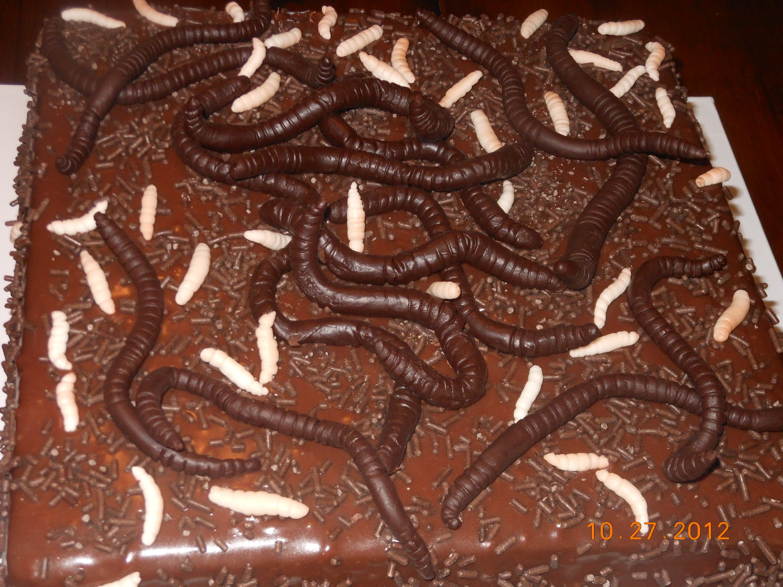

Slide 13
It’s only cake!

Slide 14
What can you say about this woman? (if you know who this is, don’t say anything!)

Slide 15
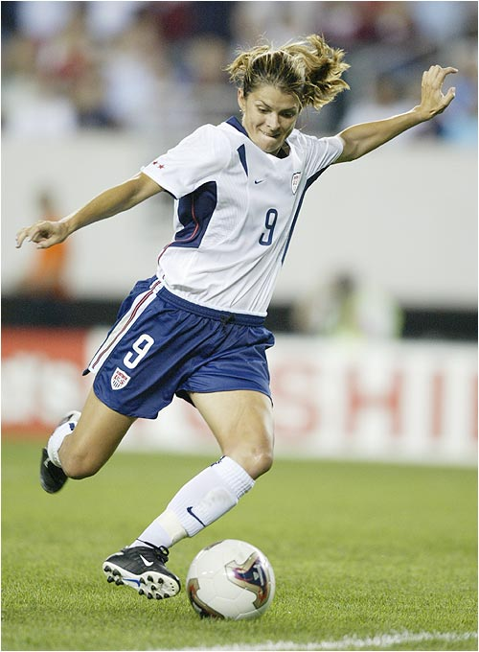
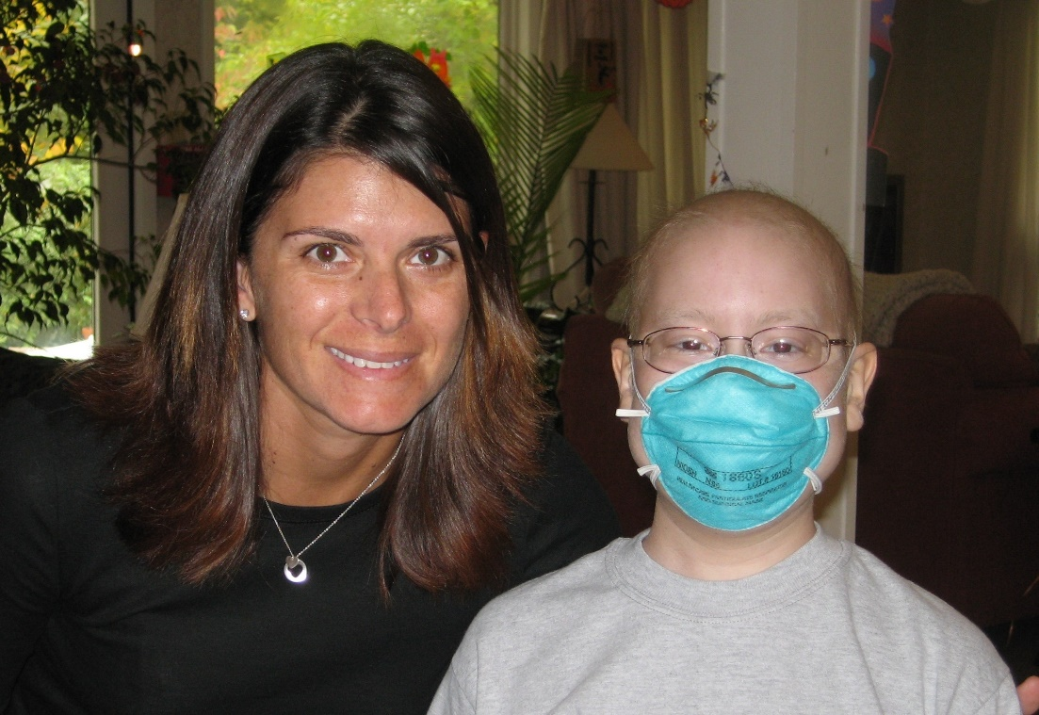
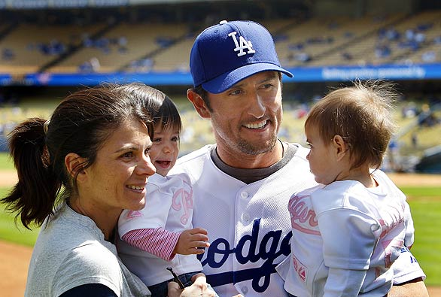
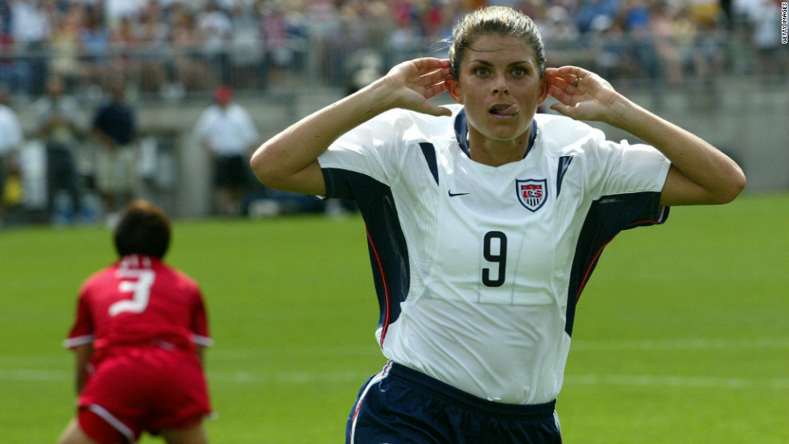
Mia Hamm
How do these pictures affect your first assumptions?

Slide 16
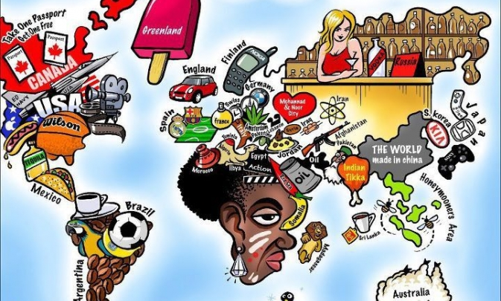

Slide 17
Article
You will be divided into groups of 4.
Each of you in your group will get a different article.
Read your article and answer the questions.
Then meet as a group and share the article’s main argument and your thoughts.
Lastly, answer the reflection questions.

Slide 18
How to Stereotypes Help Us? Hurt us?
???

Slide 19
How to Stereotypes Help us? Hurt us?
“A generalization such as this doesn’t allow for diversity within groups and may result in stigmatization (marking someone as disgrace) and discriminations(the unjust or prejudicial treatment of different categories of people) of groups if the stereotypes linked to them are largely negative. That said, even so-called positive stereotypes can be harmful due to their limiting nature. Whether stereotypes are positive or negative, they should be avoided.”

Slide 20
Much of what enters our consciousness, of course, comes from the culture around us.
“Our society talks out loud about justice, equality, and egalitarianism, and most Americans accept these values as their own. At the same time, such equality exists only as an ideal, and that fact is not lost on our unconscious. Images of women as sexobjects, footage of African-American criminals on the six o'clock news,—"this is knowledge we cannot escape," explains Banaji. "We didn't choose to know it, but it still affects our behavior."
"Children don't have a choice about accepting or rejecting these conceptions, since they're acquired well before they have the cognitive abilities or experiences to form their own beliefs." And no matter how progressive the parents, they must compete with all the forces that would promote and perpetuate these stereotypes: peer pressure, mass media, the actual balance of power in society.
We create stereotypes to explain why things are the way they are. "Stereotypes don't have to be true to serve a purpose."

Slide 21
Connect
We will be watching/listening to a slam poem from Prince Ea called “I am NOT Black, YOU are NOT White”.
Be prepared to respond to a writing prompt regarding the poem’s perspective on Stereotypes.
https://www.youtube.com/watch?v=q0qD2K2RWkc

Slide 22
Video clip
Why do you think people label other people?
Do you agree or disagree with Prince Ea’s message on stereotypes? Why/Why not?
Write down a list of stereotypes that have been or could be associated with you.
Which of these stereotypes do you play into, on purpose or not?
Do any of these stereotypes offend you? Why?

Slide 23
Our goal:
We can’t avoid stereotypes, but we can teach our minds to use assumed judgement more positively.
This is a skill, and something that takes time.
One way we can begin letting go of our generalized assumptions is to identify and challenge assumptions and stereotypes related to us.

Slide 24
Expand: Writing your own Poem
Write a poem based on stereotypes about your own identities.
In the poem, you will also get to debunk the stereotypes by stating positive traits about yourself.
You may choose to use the form that I will be providing, or you may choose to write in your own style.
If you choose the latter, be sure that your poem has:
At least 20 lines
Contains stereotypes about your identity
Contains positive traits about yourself that prove the stereotype wrong

Slide 25
Example: by Ms. Bugica
Just because I am a teacher,
doesn’t mean I don’t have a life outside of the school building.
doesn’t mean that I’m always right.
doesn’t mean that I can’t “do”.
I am an achiever.
Just because I teach English literature
Doesn’t mean I am great speller
Doesn’t mean I love everything that I read
Doesn’t mean I am always reading
I am poet.
Just because I am a woman,
Doesn’t mean I’m a damsel in distress
Doesn’t mean my appearance is my only asset
Doesn’t mean I have to do “girl” push-ups.
I am a long-distance runner.
Just because I speak softly
Doesn’t mean I am timid and shy
Doesn’t mean I don’t get angry
Doesn’t mean I don’t have anything important to say.
I am a leader.

Slide 26
You will have ~ 15-25 minutes to work on your poems.
We will be sharing these as a class.
Remember, practice being as confident in front of people as you are in claiming your identity. Be as confident in real life as you are behind a screen.

Slide 27
Exit Slip: Reflection-
Why are stereotypes dangerous?
As you have learned how others are mis-viewed, how can you prevent yourself and/or others from incorrectly stereotyping others? How can you promote awareness?

Slide 28
Sources
https://www.thoughtco.com/what-is-the-meaning-of-stereotype-2834956
https://courses.lumenlearning.com/sociology/chapter/stereotypes-prejudice-and-discrimination/
https://www.psychologytoday.com/us/articles/199805/where-bias-begins-the-truth-about-stereotypes

Slide 29
Example:
Just Because
Anonymous teen girl, San Diego CA
Just because I am Mexican,
Doesn’t mean I speak Spanish
Doesn’t mean I am “illegal”
Doesn’t mean I’m illiterate
I am a good reader.
Just because I am a girl,
Doesn’t mean I like to shop
Doesn’t mean I am boy crazy
Doesn’t mean I can’t play sports
I am a loyal friend.
Just because I’m Catholic,
Doesn’t mean I go to church
Doesn’t mean I read the bible
Doesn’t mean I am better than you
I am a nice person.
Just because I am young,
Doesn’t mean I am naïve
Doesn’t mean I don’t care
Doesn’t mean I will “understand someday”
I am a human being.

