Slide 1
Choices- Making informed Decisions
Sit Dolor Amet

Slide 2
Goals & Focus Questions
Explain why people have to make choices when faced with different alternatives
Identify a choice and the opportunity costs of that choice
Analyze personal choices to determine the benefits received and the benefits forgone
Evaluate the rationality of choices.
How do my decisions impact my future?
How can I make good decisions?

Slide 3
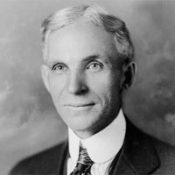
“There is one rule for the industrialist and that is: make the best quality goods possible at the lowest cost possible, paying the highest wages possible.”
Henry Ford
Entrepreneur
Founder of Ford Motor Company
This Photo by Unknown Author is licensed under CC BY-NC
Notes:
How do you feel about the quote? People who follow this advice are making a choice. Most choices, if rational, involve benefits we expect to gain as well as benefits we forgo by not choosing a different option. What could Ford have chosen to do instead of following his own advice in the quote?

Slide 4
Following Ford’s Advice
Benefits received
Benefits forgone
Notes:
The profits, customers, suppliers, and relaxation Ford gave up are called his opportunity costs.

Slide 5
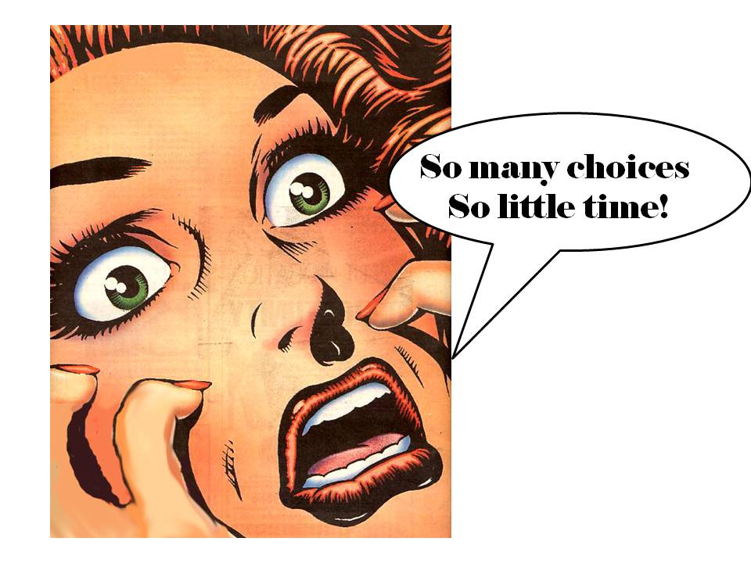
Life is full of Choices
Where actions have consequences, choices involve an opportunity costs
For big choices in life, thinking rationally about the benefits and the opportunity costs of our choices can help us lead better lives.
To get us thinking a little more deeply about how decisions affect us, you are going to change your identity.

Slide 6
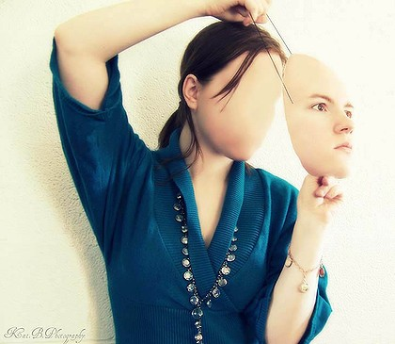
Identity Swap
You will be given a new name, and a new life.
The goal of this activity is to experience a new life and life it quickly.
Your new life begins at the age of 18 and ends at retirement age (or maybe sooner?)
At what age do people retire from work?

Slide 7
Your New Life
Your new life will include choices.
These choices may have led to good things later or bad things.
Some of your choices in your young age will affect you for the rest of your life.
As you read your life scenario, circle key events or decisions and make notes of vocabulary words you might not understand.
Record your insights on your scenario Analysis Worksheet
This Photo by Unknown Author is licensed under CC BY-SA

Slide 8
New Life Analysis
Who likes your new life?
Who doesn’t like your new life?

Slide 9
The timeline of life.
What happened to people at:
Age 18?
25?
35?
45?
55?
65?

Slide 10
Your life, Your Choice (4 corners)
Now that you’ve had a chance to live in someone else’s shoes, let’s begin thinking about your choices, and your future.
On the “Life after High School Record Sheet”, select only one option out of the four for each of the five categories.
You will indicate your choice by walking to one of the four corners.
BEFORE YOU MOVE… you will also be recording the choices of one your classmates. Mentally choose someone, not out loud, whom you think is the most different from you. Don’t reveal your choice, just silently mark your answers on your paper.
This Photo by Unknown Author is licensed under CC BY-ND

Slide 11
Reflect
How many of you found that the secret person you watch was indeed, really different from you?
How many of you found that your secret person was similar?
What can you say about the class as a whole based on what you saw?
This Photo by Unknown Author is licensed under CC BY

Slide 12
Opportunity Costs
So we’ve looked at someone’s else life and their choices and we’ve shared our choices.
Now we are going to think about the benefits and costs of making choices.
Enter the choice you made for your education in column one the handout.
Then choose the next best alternative for your education and put that in the second column.
Complete this exercise the same way we did with Henry Ford.
This Photo by Unknown Author is licensed under CC BY-NC

Slide 13
Example: Choice five: hobbies
Your Hobbies: Extreme Sports
Alternative: Home-Based
What did you gain by choosing your hobby over the next best alternative?
1. outlet for stress, fulfills need for competition
2. be more social and make more friends
What is your opportunity costs by choosing your hobby over your next best alternative?
1. personal safety- extreme sports pose a serious health risk over home-based hobbies
2. time/money/commitment to maintain safety

Slide 14
Reflection:
If we think back to the factors that influence our identity, what role does our identity play in making our future decisions?
What role do our decisions make in shaping our identity?
How can we make choices to ensure a healthy future?
This Photo by Unknown Author is licensed under CC BY

