Slide 1
Elements of a Documentary
Friday, Sept 14th

Slide 2
Today’s goals & focus questions:
-analyze how visual texts differ from printed texts
-Identify the elements within a documentary
-determine a main idea for a documentary clip
*How do we analyze a story in a film?
*What strategies can we use to determine the main idea?

Slide 3
What is a Documentary?
https://www.youtube.com/watch?v=uG5j9HJOMrk

Slide 4
What is a Documentary?
“A documentary film is a nonfictional motion picture intended to document some aspect of reality, primarily for the purposes of instruction, education, or maintaining a historical record.”
~ Wikipedia
Key words???

Slide 5
OBJECTIVE vs. BIAS
Objective, or objectivity, is when something is without opinion, only facts
An objective summary tells what happens, and ONLY what happens
Example: Liberty is a short story about a girl who sacrifices her dog for a greater freedom.
Bias is when something contains opinions
If an article or documentary contains bias, it means that have a preference or opinion that they are displaying in their text.
Example: Liberty is a great short story about a trouble-making and annoying girl who honorably sacrifices her dog for a greater freedom in the wonderful country of the U.S.

Slide 6
The 6 elements of a documentary
Narration
Evidence
Interview
Expert Witness
Cutaways
Footage:
Still Shots
“Cinema Verite” –Live Action
Primary footage
Archival footage

Slide 7
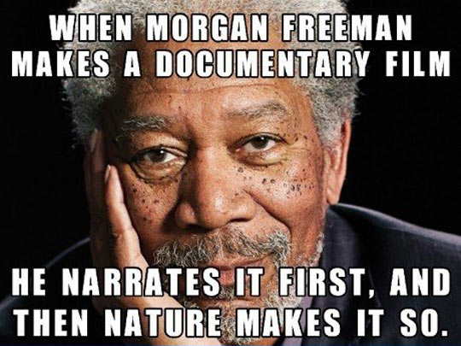
Narration:
Aka: The Voice of God
This is the voice-over heard in the movie
In narrative films (think Disney) voice-over offers exposition and personal comments.
BUT On documentaries voice-over is used to state unquestionable truths.
If you hear the sentence “There are only 80 pandas left in the entire world” spoken by a deep voice, you will believe it.
That’s the reason why most narrators are men and many from Britain – apparently the British accent is more persuasive than American English.
Unless you’re Morgan Freeman…

Slide 8
Evidence
Because Documentaries are presenting real life, they sometimes have to present evidences or documentation to make their point convincingly.
The sources need to be legitimate
Newspaper articles, bank statements, government records, surveillance footage are all fair game for the filmmaker because they carry the weight of truth.
For the most part, at least. Occasionally, directors may intentionally misuse documents and take it out of context to mislead the audience.
Logo here

Slide 9
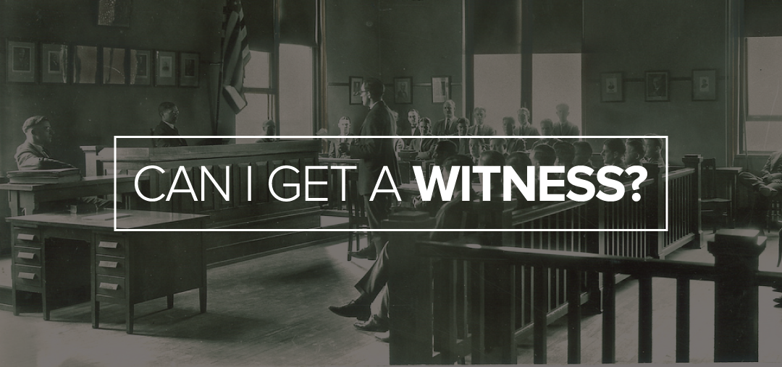
Evidence (2 types)
Interviews: Provide evidence when the filmmakers might not have been able to film.
Example: Film about a title 1 school and the “history” at the school.
Expert Witness: is anyone that has great knowledge on the subject that they are testifying on.
Example: film about decline of wild pandas from a film-maker who studied film and journalism in college.
Logo here

Slide 10
Cutaways
In film and video, a cutaway shot is the interruption of a continuously filmed action by inserting a view of something else.
It is usually, although not always, followed by a cut back to the first shot, when the cutaway avoids a jump cut.
The cutaway shot does not necessarily contribute any dramatic content of its own, but is used to help the editor assemble a longer sequence.
For this reason, editors choose cutaway shots related to the main action, such as another action or object in the same location.
For example, if the main shot is of a man walking down an alley, possible cutaways may include a shot of a cat on a nearby dumpster or a shot of a person watching from a window overhead.
These can tell a story without narration, use shots to evoke emotion, or as fillers between “chapters”
Logo here

Slide 11
Footage
A length of film
Still Shots
Photograph within a film
Cinema Verite (Live Action)
Filming whatever is going on
Filmmakers are not interacting
Primary footage
Footage that the filmmakers shoot themselves
Archival Footage
Footage from someone else
Usually paid for or in “free-use”
Typically older footage, footage from local stations, etc.
Logo here

Slide 12
Documentary Modes
Aka, subgenres of documentaries

Slide 13
Documentary Modes
In documentary film and video, we can identify six modes of representation that function something like sub-genres of the documentary genre itself: poetic, expository, participatory, observational, reflexive, performative.
These six modes establish a loose framework of affiliation within which individuals may work; they set up conventions that a given film may adopt; and they provide specific expectations viewers anticipate having fulfilled.

Slide 14
Poetic
Instead of using traditional linear continuity to create story structure, the poetic documentary filmmaker arrives at its point by arranging footage in an order to evoke an audience association through tone, rhythm, or spatial juxtaposition.
These films often bear a close resemblance to experimental and avant-garde film.
Following in the tradition of Godfrey Reggio's Qatsi Trilogy, Ron Fricke's breathtaking 70mm Samsara is a fine example.

Slide 15
Expository Documentary
constructs a specific argument or a point of view for the audience.
This is the model that is most often associated with documentary in general.
The structure is grounded in a series of assertions backed up by evidence.
The assertions are presented through verbal commentary from an invisible voice-over narrator, while images provide the evidence.
Generally, the formula is a resonating, authoritative voice (like the silky baritone of Morgan Freeman in March of the Penguins) that tells you something with corresponding footage proving that it is, indeed, true.

Slide 16
Observational Documentary
In reaction to previous forms of documentary and to changing camera technology, both Direct Cinema and Cinema Verite movements started to appear in the 1960s that embraced observational documentary -- that is, the filmmaker observing truth by letting the camera capture its subjects uninterrupted.
This mode uses the observations of an unobtrusive camera to create direct engagement with the everyday life of subjects.
The seminal film Salesman from the Maysles Brothers and Charlotte Zwerin features all the skinny ties, cigarettes, and oversized bibles you could ever want as seen in this brilliant trailer.

Slide 17
Participatory Documentary
Around the same time as Direct Cinema style of observing without interfering showed up, so did the opposite sensibility.
This mode emphasizes the interaction between filmmaker and subjects.
These films usually take the form of a series of interviews or other forms of even more direct involvement from conversations to provocations.
Archival footage to examine historical issues is also included.
The first-person storytelling accounts shared with Errol Morris in his breakout film The Thin Blue Line should be in every filmmaker's must-watch queue

Slide 18
Reflexive Documentary
Reflexive documentary is not about the relationship with the filmmaker and the subject, but rather the filmmaker and the audience.
This mode, which includes the mockumentary format, calls attention to the assumptions and conventions that govern documentary filmmaking to increase our awareness of how films construct representations of reality.
Showing the man (or woman) behind the curtain to the audience should shake the core of the whole damned process of storytelling, as in Sarah Polley's masterful Stories We Tell.

Slide 19
Performative Documentary
Showing up in the 1980s along with the reflexive sub-genre, the performative documentary emphasizes truth as relative, favoring a personal take over the objective lens.
This mode highlights the subjective or expressive aspect of the filmmaker’s own involvement with a subject to heighten the audience’s responsiveness to the subject and to this involvement.
These films reject objectivity and favor emotion.
You can see the subjective poetics of autobiographical experience in the trailer for Marlon Riggs' Tongues Untied.

Slide 20
Watch Film, take notes
https://www.youtube.com/watch?v=1jvtiVIW5zQ

Slide 21
You try!
Watch the following example films, and try to identify the parts.
https://www.youtube.com/watch?v=kRhJJzylHvw (10)
Logo here

Slide 22
THANK YOU
Sources:
https://nofilmschool.com/2015/09/nichols-6-modes-documentary-can-help-expand-your-storytelling
https://www.meridianstories.com/archive/resources/creative-how-to-guides/six-principal-modes-of-documentary-filmmaking/

