Slide 1
In a Flash: Flash Fiction

Slide 2
Friday, Oct 5th Warm-up (~5min)
Leave the printouts on your desk alone for now (we’ll get to them later!)
On a sheet of notebook paper, answer the following question in a list, paragraph, or bubble chart:
What does a story need, in order to be a story?
Hint: think back to our conversations about “elements of a short story” and the “plot diagram” graphic organizer.
Consider: the stories we’ve read, heard, and discussed as well as your own.

Slide 3
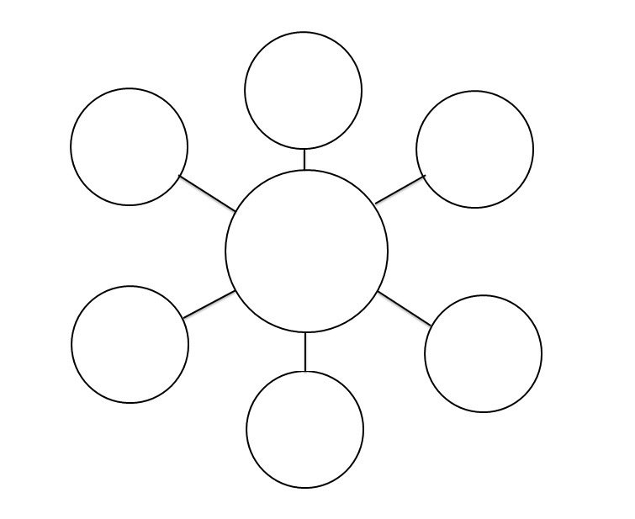
Story

Slide 4
Today’s
Goals:
Focus Questions
Analyze articles and construct a definition of flash fiction
Justify what elements are needed in order to have a (good) story
Annotate (guided) a Flash Fiction story to help you redefine Flash Fiction
End Goal: Create your own Flash Fiction piece to help you understand, reflect, and answer one of our Essential Questions.
What are the essential elements of a story?
How can writing flash fiction help us become better writers and readers?
Essential Question
#2:How can we use these stories (ones we write or ones we read) to understand ourselves, others, and the world?

Slide 5
(Goal 1) Think (&read!), Pair, Share (~12 min)
Read the following story
Answer the questions. Independently.
Find a Partner and discuss
Stay on topic
Listen to each other
Attack the argument, not the person
Talk at an appropriate volume
Express your ideas clearly and concisely
Share to the class
Raising your hand

Slide 6
(Goal 1) Think (&read!), Pair, Share
Story by Earnest Hemmingway
For sale: baby shoes, never worn.

Slide 7
Goal 2: Read article and define Flash Fiction “Going Long, Going Short” (~12 min)
Blue Sheet of paper
Pass the Frog Read
Call person’s name
Gentle throw
Read at least a sentence
Don’t stop mid-sentence

Slide 8
Main Idea
Remember: subject+ one main piece of description = main idea
Your own definition:

Slide 9
Let’s Discuss!
1.Paragraph 1: According to the author, how is the narrative form of the novel particularly suited to America?
2. 2nd to last paragraph: What do you think Mr. Faulkner means by “Such evocative, fragmentary brevity makes this Twitter and Facebook era perfect for flash fiction. Flash allows literature to be a part of our everyday life, even if we are strange multitasking creatures addled by a world that demands more, more, more”? Do you agree?

Slide 10
Goal 3: Read the FF story “A Short Story” by Larry French, and following the directions with the annotation guides. Then answer questions in complete sentences from the packet (~25 min)
As our next unit will be a novel study, it will be helpful for you to gain skills in annotation.
The following Flash Fiction has been divided up over several pages to include guided annotation notes.
Read through the story, answer the questions along the way, and follow the annotation guidelines.
Red pens on Stool!

Slide 11
Independently read and annotate according to the guided notes
Then find a partner and discuss; Remember to:
Stay on topic
Listen to each other
Attack the argument, not the person
Talk at an appropriate volume
Express your ideas clearly and concisely
Ticket out the Door: Answer the final question on page 1 in the Guiding Worksheet:
Do you think Flash Fiction counts as a story? Why, why not?

Slide 12
Goal 4: Write your own Flash fiction
You are going to try your hand at condensing a classroom text and/or Disney movie into very few words.
Try to get it into 6 words!
If you’re struggling, get it under 15. If you’re still challenged, go for 50 words or less.
But really, less is more!
Then answer the questions about your flash fiction piece.

Slide 13
Hunger Games
“I volunteer as tribute!” Destroys capitol.
Family Feud, their children’s marriage=death.
Father-son don’t get along; universe suffers.
Guy joins army, runs, eats chocolates.
Girl observes prejudice. There’s no bird.
Son seeks revenge for ghost-Father. dies.
“Romeo and Juliet”
“Star Wars”
Forest Gump
To Kill a Mockingbird
Hamlet

