Slide 1
Literary Genres
September 6th 2018

Slide 2
Today’s Goals:
Define genre
Identify common genres within literature
understand sub-genres

Slide 3
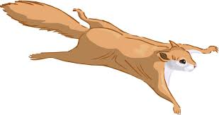
What is a Genre?
Genres are categories of things placed together for their similarities
“A literary genre is a category of literary composition. Genres may be determined by literary technique, tone, content, or even (as in the case of fiction) length.
The distinctions between genres and categories are flexible and loosely defined, often with subgroups.”
Think of itunes- search by genre

Slide 4
Organize (use a pencil!)
Organize the following words into their categories
No cheating!
Try to see what you remember yesterday
You may work with the people around you
Do your best; I know you might not get them all right!

Slide 5
Hint: Underlined words go in the large boxes
Essay
Ode
Dramatic
Myth
Novella
comedy
Epic
Fiction
legend
Elegy
Flash fiction
Blank verse
novel
Folktales
narrative
Biography
musical
essay
Fairy tales
tragedy
Nonfiction
melodrama
Fables
Prose
Diary
Poetry
monologues
Sonnet
News article
Ballads
Tall tales
Memoir/autobio.
Drama
Prose poetry
History
lyric

Slide 6
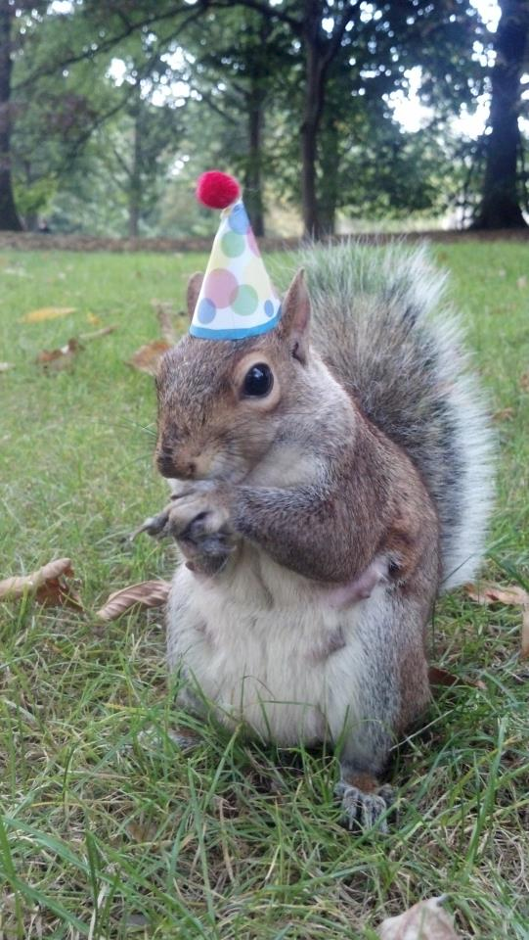
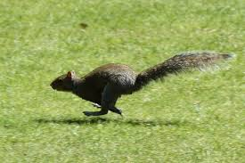
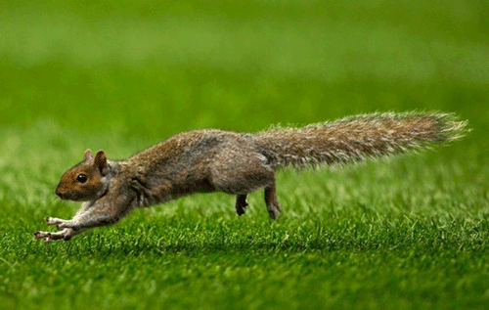
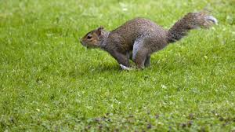
Genres in Literature
History
Drama
Sonnet
Tragedy
Tall Tale
Elegy
Novel
Comedy
Ode
Fable
Novella
Melodrama
Epics
Myths
Short Story
Musical
Ballads
Flash Fiction
Fairy Tales
Poetry
Lyric
Blank Verse
Narrative
Folktales
Legends
Dramatic
Monologues
Narrative
Prose
Biography
Prose
Fiction
Memoir/
Autobiography
Non Fiction
Essay
Diary/Journal
News Article

Slide 7
Which ones do we need to know?
I won’t be covering all of these in class.
SO….Check out this PPT. on my website if you need help
We’ll be dissecting each of these topics in their own units later on (novels/novella next, then drama, then poetry, etc.)
What we need for unit 1: Narrative Poem & All of Prose
What don’t you know?

Slide 8
How to understand Genres in Literature
Classic three forms of Ancient Greece:
Drama
Poetry
Prose
History
Tragedy
Comedy
Melodrama
Musical
Lyric
Narrative
Dramatic
Prose
Fiction
Non-Fiction

Slide 9
Oh the DRAMA

Slide 10
Drama
Drama is the genre of literature that’s subject for compositions is dramatic art in the way it is represented.
This genre is stories composed in verse or prose, usually for theatrical performance, where conflicts and emotion are expressed through dialogue and action.
Drama is meant to be seen (through physical actions) and heard
Reading drama can be difficult as the reader must IMAGINE what would be happening on a stage.
Stage directions also appear in the text version of drama

Slide 11
History
Tragedy
Drama
Comedy
Melodrama
*** This isn’t all of them, but some you should know***
Musical

Slide 12
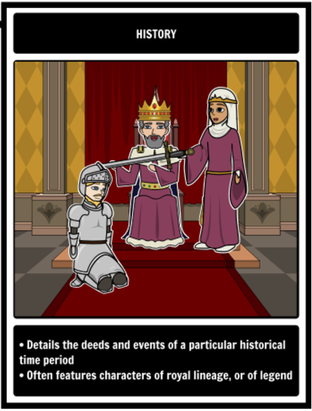
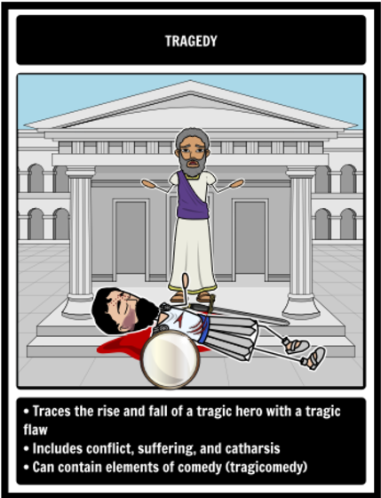
+Catharsis-the process of releasing, and thereby providing relief from, strong or repressed emotions.
+

Slide 13
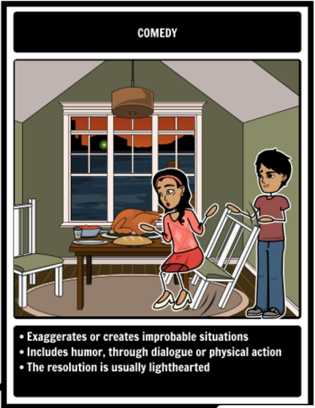
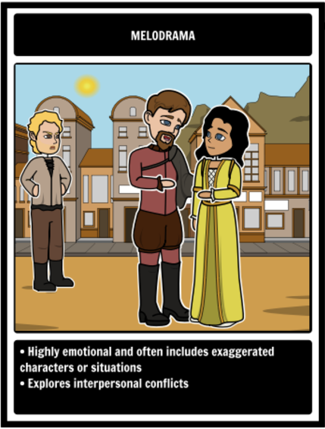
+ Comedy here doesn’t mean, Ha-Ha funny. It can contain elements of humor, but it just means happy ending.
+

Slide 14
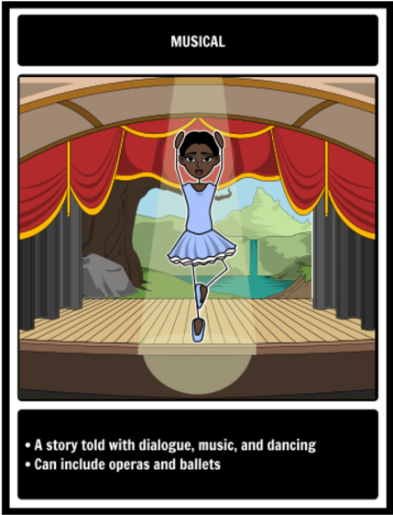
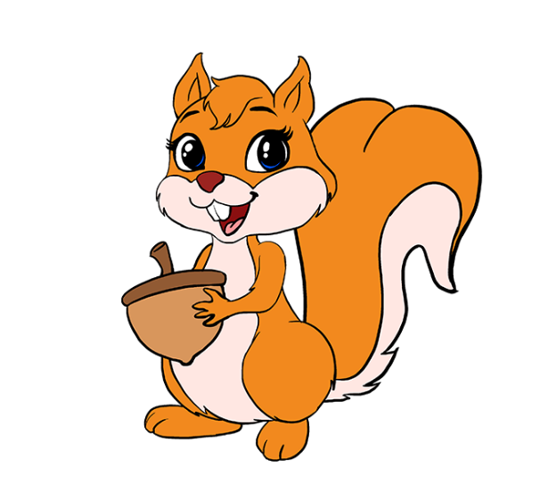
Musical

Slide 15
Examples:
Histories- Henry IV, Stuff Happens
Tragedies- Romeo and Juliet, Hamlet, Cyrano De Bergerac
Comedies- Midsummer Night’s Dream, The Importance of Being Earnest
Melodramas- Up, The Fault in Our Stars
Musicals- High School Musical, Hamilton

Slide 16
A thousands lives in a single POEM
Poetry

Slide 17
Sonnet
Elegy
Lyric
Ode
*** This isn’t all of them, but some you should know***
Epics
Poetry
Narrative
Ballads
Dramatic
Blank Verse
Monologues
Prose

Slide 18
Poetry
literary work in which special intensity is given to the expression of feelings and ideas by the use of distinctive style and rhythm; poems collectively or as a genre of literature.
Poetry encompasses a variety of different sub-subgenres
In the era of postmodernism (today) the art of poetry is so vast that anything can be considered “art” or “poetry”
There are lots of poems, but not always a lot of good poetry.

Slide 19
Poetry Subgenres
The great philosopher Aristotle suggested that poetry is divided into three genres.
Aristotle claimed comedy is an imitation of what is inferior in a way that is laughable. He then said that both tragedies and epics are made to portray suffering in a way to produce certain effects with the only difference between the two being epics used a one-verse form and is narrative.
Today, poetry is still considered the owner of the three main poetic forms: lyric, narrative, dramatic*
Each form can then be divided into many subdivisions, each consisting of a rhyme scheme, rhythm and/or style.

Slide 20
Lyric Poetry
An emotional writing focusing on thought and emotion - can consist of a song-like quality.
The term derives from a form of Ancient Greek literature, the lyric, which was defined by its musical accompaniment, usually on a stringed instrument known as a lyre. (But not today!)
Lyric poetry does not attempt to tell a story.
Popular lyric poems include the works of
Sappho, "Go, lovely Rose" by Edmund
Waller and the many sonnets of William Shakespeare.

Slide 21
Sonnet, Elegy, Ode
Sonnet- 14 lined poem written in meter, usually about love. There are two types. We will be reading some this year during our Shakespeare Unit!
Elegy- a poem of serious reflection, typically a lament for the dead. Often written in meter.
Ode- poem in the form of an address to a particular subject, often elevated in style or manner and written in varied or irregular meter.

Slide 22
Narrative Poetry
A poem which tells a story.
It often marks the voices of a narrator and characters as well
and the entire story is usually written in metered verse.
Narrative poems do not have to follow rhythmic patterns.
The poems that make up this genre may be short or long, and the story it relates to may be complex. It is normally dramatic, with objectives, diverse characters, and metre.
Popular narrative works are "The Canterbury Tales" by Geoffrey Chaucer, "The Divine Comedy" by Dante, "Hiawatha" by Henry Wadsworth Longfellow, "Raven" by Edgar Allan Poe, "The Rape of Lucrece" by Shakespeare and "The Rape of Lock" by Alexander Pope.

Slide 23
Narrative Poetry Subgenres
Epics
Ballads
Also epos, or epopee
lengthy narrative poem, ordinarily concerning a serious subject containing details of heroic deeds and events significant to a culture or nation
Example: The epic of Gilgamesh
Example: The Odyssey
a poem or song narrating a story in short stanzas.
Traditional ballads are typically of unknown authorship, having been passed on orally from one generation to the next as part of the folk culture.
Meant to be sung and/or accompanied by music
Example: Elvis Presley, The Rime of the Ancient Mariner

Slide 24
Dramatic Poetry
Dramatic poetry is any poetry that uses the discourse of the characters involved to tell a story or portray a situation.
Dramatic Poetry, therefore is also apart of DRAMA because it is meant to be spoken aloud and acted out.
It is any drama written in verse which is meant to be spoken, usually to tell a story or portray a situation.
The majority of dramatic poetry is written in blank verse.
Other forms of dramatic poetry include, but are not limited to, dramatic monologues, rhyme verse and closet drama.
Important dramatic works include those by Shakespeare, Ben Jonson and Christopher Marlowe.

Slide 25
Dramatic Poetry definitions
Monologues
Blank Verse
verse without rhyme, especially that which uses iambic pentameter.
We will be learning more about verse/meter later this year.
is a speech presented by a single character
most often to express their mental thoughts aloud
sometimes also to directly address another character or the audience.

Slide 26
Prose in Poetry
Prose poetry is written like prose, in paragraphs rather than verse
but contains the characteristics of poetry, such as poetic meter, language play, and a focus on images
rather than narrative, plot, and character (general prose)

Slide 27
Prosey Prose

Slide 28
Prose
written or spoken language in its ordinary form, without metrical structure.
Any written work that has no inherent rhythm or poetic qualities by nature, written in common grammatical language.
Normal writing/reading materials- most of what you encounter in school

Slide 29
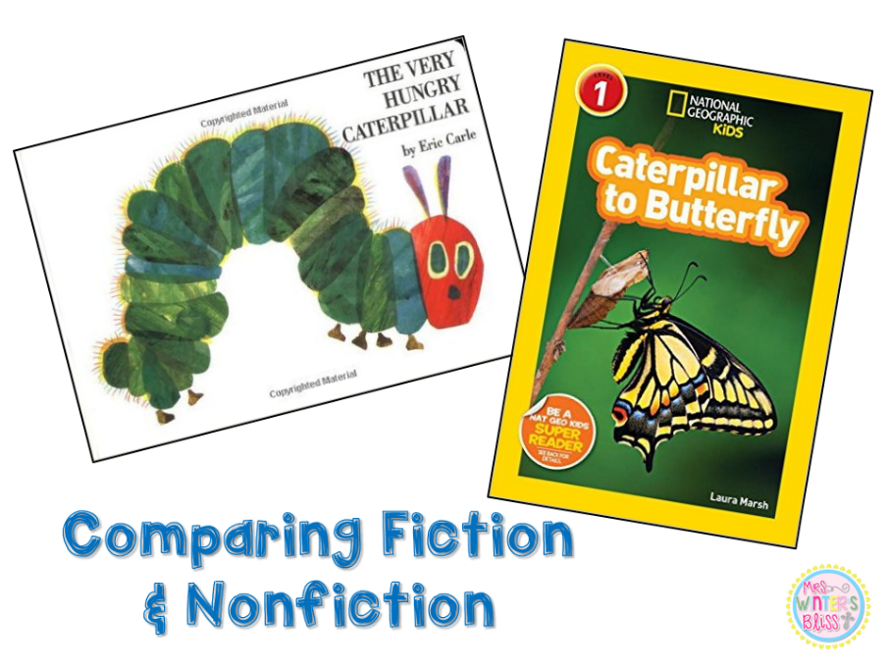
Subcategories of Prose
Fiction
Non Fiction
Fiction is narrative writing that originates from the author’s imagination. It is designed to entertain, but it can also inspire, inform, or persuade.
Nonfiction is writing that is based on true events, people, places, and facts. It is designed to inform, and sometime

Slide 30
Tall Tale
Novel
Fiction
Novella
Fable
Short Story
Myths
*** This isn’t all of them, but some you should know***
Flash Fiction
Fairy Tales
Folktales
Legends
Narrative
Nonfiction
Biography
Memoir/
Autobiography
Essay
Diary/Journal
News Article

Slide 31
Fiction- Subgenres
Novel- is any relatively long, written work of narrative fiction, normally in prose, and typically published as a book

Slide 32
Fiction- Subgenres
Novella- is a text of written, fictional, narrative prose normally longer than a short story but shorter than a novel.

Slide 33
Fiction- Subgenres
Short Story- a story with a fully developed theme but significantly shorter and less elaborate than a novel.

Slide 34
Fiction- Subgenres
Flash Fiction-work of extreme brevity, that still offers character and plot development, including the Six-Word Story, 140-character stories, also known as "twitterature", the "dribble" (50 words), the "drabble" (100 words), "sudden fiction" (750 words), and "micro-fiction“

Slide 35
Fiction- Subgenres
Folktales- stores that have been passed down over the years by word of mouth. Many different cultures have folk tales with similar themes, motifs, and character types.

Slide 36
Fiction Folk Tale Subgenres
Myths- a traditional story, especially one concerning the early history of a people or explaining some natural or social phenomenon, and typically involving supernatural beings or events.

Slide 37
Fiction Folk Tale Subgenres
Fairy Tales- folktales that contain elements such as happy ending, magic, elements that occur in 3’s, stock characters such as the wicked witch, handsome prince, and damsel in distress.

Slide 38
Fiction Folk Tale Subgenres
Fables-fictional story, in prose or verse, that features animals, legendary creatures, plants, inanimate objects, or forces of nature that are anthropomorphized (given human qualities, such as the ability to speak human language) and that illustrates or leads to a particular moral lesson (a "moral")

Slide 39
Fiction Folk Tale Subgenres
Tall Tales- folktales that have key element of exaggeration, such as Paul Bunyan

Slide 40
Fiction Folk Tale Subgenres
Legends- a story coming down from the past; especially : one popularly regarded as historical although not verifiable

Slide 41
Prose Subgenre
Non Fiction- Meant to portray real life
Keep in mind, how object you can be when you write about an emotional event or time in your life.
As you read non fiction, know that the writer’s aim to convey real events in an interesting manner.

Slide 42
Non Fiction Subgenres
Narrative Non Fiction- Tells a story or a series of events

Slide 43
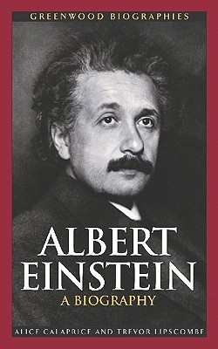
Non Fiction Subgenres
Biography- chronicles a person’s life story but is written by another person

Slide 44
Non Fiction Subgenres
Memoir-account of a person’s life written by that person. Includes one central event.
Example: The Story of my Battle with Cancer
Autobiography- account of a person’s life written by that person. Includes entire life story.
The autobiography of Fredrick Douglas

Slide 45
Non Fiction Subgenres
Essay- a short piece of writing on a particular subject

Slide 46
Non Fiction Subgenres
Diary/Journal- A personal diary may include a person's experiences, and/or thoughts or feelings, including comments on current events outside the writer's direct experience.
Although a diary may provide information for a memoir, autobiography or biography, it is generally written not with the intention of being published as it stands, but for the author's own use.

Slide 47
Non Fiction Subgenres
News Articles/ Web articles- discusses current or recent news of either general interest (i.e. daily newspapers) or of a specific topic (i.e. political or trade news magazines, club newsletters, or technology news websites).
A news article can include accounts of eyewitnesses to the happening event.

Slide 48
Review

Slide 49
Recap: Genres
Fancy name for categories in which we divide literature based on their similarities in styles, structure, format, language, etc.

Slide 50
Genres in Literature
History
Drama
Sonnet
Tragedy
Tall Tale
Elegy
Novel
Comedy
Ode
Fable
Novella
Melodrama
Epics
Myths
Short Story
Musical
Ballads
Flash Fiction
Fairy Tales
Poetry
Lyric
Blank Verse
Narrative
Folktales
Legends
Dramatic
Monologues
Narrative
Prose
Biography
Prose
Fiction
Memoir/
Autobiography
Non Fiction
Essay
Diary/Journal
News Article

Slide 51
Genre Worksheet:
Your turn to practice!
Now I know… I didn’t go through all of these notes in class.
Do the ones you know on the worksheet.
Use context clues to help you answer the other ones
Visit my website to review notes to finalize answers.
HW if don’t finish.

Slide 52
Sources
Any questions? Be sure to review this PowerPoint on my Website if you need to reference it!
You will have a QUIZ on this in the near future!
http://www.poemofquotes.com/articles/three-genres-of-poetry.php
http://www.storyboardthat.com/articles/e/literary-genres
http://genresofliterature.com/
http://www.dpi.state.nc.us/curriculum/

