Slide 1
Warm up 5/17
On a sheet of notebook paper, describe your learning style. How do you think you learn best?

Slide 2
Learning Styles

Slide 5
Complete this part WITHOUT looking at the other side. This is to help you determine your learning styles. This is a simple test. More tests can be found online. Check your English 1 Final Exam Survival Guide/Walkthrough packet for more information.

Slide 6
Be sure to add correctly!
Don’t worry if two or all three numbers are similar- it just means you don’t have a particular way of learning that is better than the others.

Slide 7
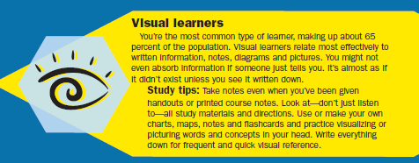
Raise your hand if you’re a…

Slide 8
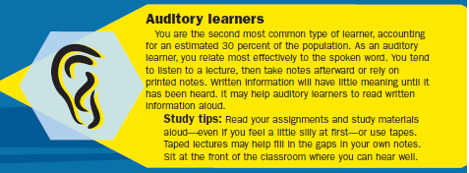
Raise your hand if you’re a…

Slide 9
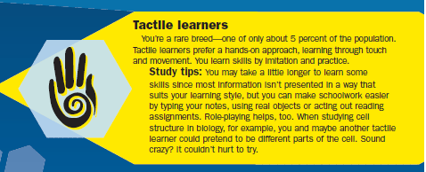
Raise your hand if you’re a…

Slide 10
What now?
Use your new/renewed knowledge of your learning style to increase your pattern of studying.

Slide 11
Goal Setting

Slide 12
Fill out the information..
Based on any goal that you may have.
It can be specific to exams, or about your life.
It must include doing well in school/exams as part of your steps.

Slide 13
Name: Roli Poli
My goal is: to join the NBA
My target date is 2025, after college ball
To reach my goal, I will do these three thing
Do well in school with grades, exams, and behavior
get into a 4-yr university
practice basketball during off-seasons
I will know I have reached my goal because: I will have a scholarship to college for basketball, I’ll be the first to graduate from High school in my family.
Two things that will help me stick to my goal are: talking to my coach and attending tutoring.

Slide 14
Gigi Poodle
My goal is: to do well on my exams
My target date is: 5/31
To reach my goal, I will do these three things:
Attend tutoring for each of my classes
Create flashcards for each subject
Spend 1 hour a day for two weeks (14 total hours) studying
I will know I have reached my goal because: my test scores will be higher than last year, I won’t be nervous about taking tests, I will pass 9th grade.
Two things that will help me stick to my goal are: using a reward system (candy) as I study, having a study competition with my friends (make up questions and quiz each other).

Slide 15
BLANK CALENDAR
For your use between May and June for your exams.
If you know you’re going to be busy on a particular day (game day, wedding, vacation) be sure to mark those days a head of time!

Slide 16
BLANK STUDY PLANNER
From 8 am to 10pm, schedule yourself in for studying.
The current time gives you 10 hours of sleep- obviously you might not need 10 hours.
You can use the other 2-4 hours as your “down” time to play games, read, do art, or whatever you do for fun. ☺

Slide 17
Effective Studying Habits

Slide 18
Review the article
In the back of your packet. Complete the chart provided for Homework.

Slide 19
Exams

Slide 20
The Week Before Exams
exercise at least 30 minutes a
Eat an extra helping of veggies or fruit at each meal this week.
Go to bed earlier than usual this week-
Try to adjust your bedtime to a slightly earlier time this week so that you won’t have trouble falling asleep the night before the exam
On Friday, or the weekend before, collect all of the items you’ll need in one place.
Continue your study plan..

Slide 21
The Day Before Exams
Drink plenty of water.
Eat a healthy dinner and skip the dessert.
DON’T cram.
Before going to bed, do something relaxing.
Go to bed early, and get some good sleep.

Slide 22
The Day of the Exam
Wake up 30 minutes early on test day.
Eat a good breakfast the morning of the test.
Avoid breakfasts with too much fat or lots of refined sugar.
Breathe! You’ve got this!

