Slide 1
Turn to Page 13 in your Survival Guide

Slide 2
NC FINAL EXAM
It
is
your
DESTINY

Slide 3
What are the Purposes of the NC Testing Program?
To assure that all high school graduates posses those minimum skills and that knowledge thought necessary to function as a member of society
To provide a means of identifying strengths and weaknesses in the educational process in order to improve instructional delivery
And to establish additional means for making the education system accountable to the public.

Slide 4
Purpose (in other words)
To make sure you know enough information and skills to be able function in the real world
To help teachers teach better
To improve the education system

Slide 5
Are NC Final Exams replacing End-of-grade (EOG) and End-of-Course (EOC) assessments?
NO. EOGs and EOCs are part of the State’s READY Accountability Model. The NC Final Exams are not part of the Accountability Model and are used in grades or subject areas
that do not have an
EOG or EOC to measure
student growth for the
state’s Educator
Effectiveness Model.

Slide 6
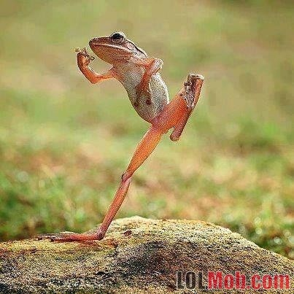
How does the NC Final exam affect a student’s overall grade average??
Results from a valid test administration should be used for a
minimum of 20%
of the student’s final
grade for each course.

Slide 7
How much time will I get to take the exam?
The administration time is 120 minutes. No administration may exceed 120 minutes, and it must be administered in one school day*. The 120 minutes does not include time fore general instructions and breaks.
*excepts made for students with accommodations

Slide 8
What type of questions are on the NC Final Exam?
Some NC final exams only have multiple choice questions for which the students have to choose the best answer. Other NC Final exams have multiple choice questions and additional questions that require students to write aa short answer.
(English 1 is all MC)

Slide 9
Which high school courses require NC Final Exams?
English I
American History II
Algebra II
English III
Physical Science
Math III
English IV
Chemistry
Integrated Math III
Civics and Economics
Physics
Advanced Functions and Modeling
U.S. History
Earth/Environmental Science
Discrete Mathematics
World History
Geometry
Precalculus
American History I
Math II
Standard Course of Study Geometry
Standard Course of Study Algebra II

Slide 10
Review: Taking the Test
Exam Name | # of ?’s | Type | Number of field test items* | Total # of ?’s | Regular amount of time to take test
NCFE Eng 1 | 40 | MC | 10 | 50 | 120 minutes

Slide 11
How will I know my grade?
Check PowerSchool
Wait until Report Cards are mailed

Slide 12
What will be on the Exam?
Everything you’ve learned this year
The skills you’ve acquired through the process of learning materials
Common Core Standards

Slide 13
Cognitive Rigor
NC Final Exams items for English 1 are
aligned to Webb’s Depth of Knowledge (DOK). Webb’s alignment model was used to classify items based on cognitive complexity.
Multiple-choice items will require students to read, comprehend, and analyze information. Also, students will be expected to analyze the reading passages; identify points of view, claims, and evidence; apply concepts and skills; and make inferences.

Slide 14
Types of Items and Supplemental Materials
NC Final Exams for English I will consist of four-response-option multiple choice items. Each form will consist of selections drawn from works of literature, which includes short story and poetry, or informational texts, drawn from the domains of History/Social Studies or Science/Technology.

Slide 15
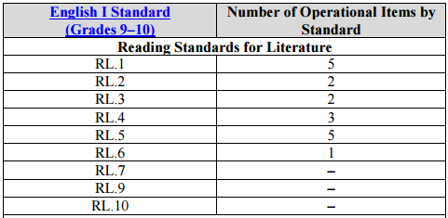
(What’s on the Test) Number of Operational Items by Standard

Slide 16
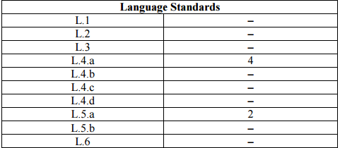
What’s on the test?

Slide 17
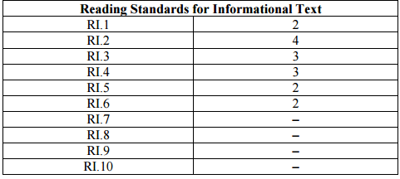
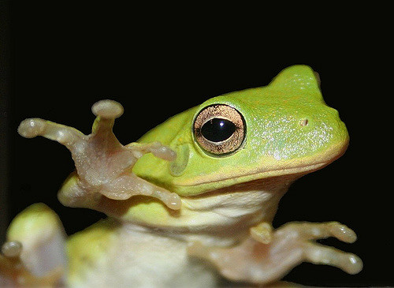
What’s on the test?

Slide 18
Reading Language Standards
RL 1 | Cite strong and thorough textual evidence to support analysis of what the text says explicitly as well as inferences drawn from the text.
RL 2 | Determine a theme or central idea of a text and analyze in detail its development over the course of the text, including how it emerges and is shaped and refined by specific details; provide an objective summary of the text.
RL 3 | Analyze how complex characters (e.g., those with multiple or conflicting motivations) develop over the course of a text, interact with other characters, and advance the plot or develop the theme.
RL 4 | Determine the meaning of words and phrases as they are used in the text, including figurative and connotative meanings; analyze the cumulative impact of specific word choices on meaning and tone (e.g., how the language evokes a sense of time and place; how it sets a formal or informal tone).
RL 5 | Analyze how an author's choices concerning how to structure a text, order events within it (e.g., parallel plots), and manipulate time (e.g., pacing, flashbacks) create such effects as mystery, tension, or surprise.
RL 6 | Analyze a particular point of view or cultural experience reflected in a work of literature from outside the United States, drawing on a wide reading of world literature.

Slide 19
Language Standards
L.4.a | Use context (e.g., the overall meaning of a sentence, paragraph, or text; a word's position or function in a sentence) as a clue to the meaning of a word or phrase.
L.5.a | Interpret figures of speech (e.g., euphemism, oxymoron) in context and analyze their role in the text.

Slide 20
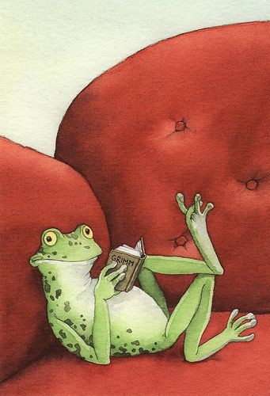
Reading Informational
RI.1 | Cite strong and thorough textual evidence to support analysis of what the text says explicitly as well as inferences drawn from the text.
RI 2 | Determine a central idea of a text and analyze its development over the course of the text, including how it emerges and is shaped and refined by specific details; provide an objective summary of the text.
RI 3 | Analyze how the author unfolds an analysis or series of ideas or events, including the order in which the points are made, how they are introduced and developed, and the connections that are drawn between them.
RI 4 | Determine the meaning of words and phrases as they are used in a text, including figurative, connotative, and technical meanings; analyze the cumulative impact of specific word choices on meaning and tone (e.g., how the language of a court opinion differs from that of a newspaper).
RI 5 | Analyze in detail how an author's ideas or claims are developed and refined by particular sentences, paragraphs, or larger portions of a text (e.g., a section or chapter).
RI 6 | Determine an author's point of view or purpose in a text and analyze how an author uses rhetoric to advance that point of view or purpose.

Slide 21
Topics Covered this year
Unit 1- RL. 1, 2, 6- Telling and Showing Stories
Unit 2- RL. 3, L 4a, 5a Shakespeare-What is love; Baby Don’t Hurt Me
Unit 3- RL. 2, 3, 5 A Dystopian Future
Unit 4- RI.1, 2, 4, 5, An Argument for Arguments
Unit 5- RI. 1, 3, 5, 6 Global Issues through Different Lenses

Slide 22
Key Vocabulary by Standard
Here is a comprehensive list of vocab that we’ve learned all year.
I think I got ‘em all!
The vocab would be a great place to start making flash cards
If you don’t know the meaning of an allegory, then you won’t be able to answer a question that asks about it.

Slide 23
Literature (Fiction)
Theme
Conflict: Man vs. Man, Man vs. Self, Man vs. Nature, Man vs. Society, Internal/external
Symbolism
Setting
Style
Tone
PLOT STRUCTURE
Introduction/Exposition
Rising action/Complication
Climax/Crisis
Resolution/denouncement
POINT OF VIEW
First Person
Third Person Omniscient
Third Person Limited Omniscient
Third Person Dramatic/Objective
Unreliable Narrator
Characterization: Round, Flat; Static, Dynamic; Protagonist, Antagonist, Foil
Comedy/Tragedy
Diction
Imagery
Irony: Verbal, Dramatic, Situational
Author’s purpose
Antagonist/protagonist
Flashback
Foil
Foreshadowing
Imagery
Mood
Archetype
Aside
Connotation/denotation

Slide 24
Language
Alliteration
Assonance
Metaphor
Onomatopoeia
Figurative Language
simile
Allusion
Synonym
Antonym
Hyperbole
Idiom
Pun
Paradox
Parody
Satire
Symbolism

Slide 25
Informational (Nonfiction)
Credibility
Context clues
Deductive reasoning
Fallacy
Invalid argument
Unsound argument
Logos
Pathos
Ethos
Evidence
Bias
Conclusion
Thesis
Inference
Informative text
Main idea
Paraphrasing
Summarizing
quoting

Slide 26
That’s all folks! (but wait…)

Slide 27
Missing anything?
If you see anything that I’m missing, let me know!
I’ll add them here to the Powerpoint as we go. ☺
Poetry terms- meter, iambic pentameter

Slide 28
Practice Writing Questions
One way to “beat” the test, is to write your own test.
I have provided three different texts in the review packet.
Follow the directions and write questions for each excerpt, keeping the standards in mind.
Then switch with a neighbor, and take their “test”.
Give back and “grade” your neighbor. How did you do? Were your questions clear? Answer choices not too obvious?

Slide 29
http://www.corestandards.org/ELA-Literacy/

