Slide 1
How to strategically answer Multiple Choice Questions
Demystifying the “K-Type”

Slide 2
Goal of Presentation
To provide students with strategies on how to prepare for exams and how to strategically answer multiple choice questions.
Improved Performance on Examinations
Preparing for Exams
Study and Test-Taking Tips
Strategically Analyze M/C Questions
Preparing for Exams
Controlling Emotions (Panic!)

Slide 3
About Multiple Choice Questions
Most commonly used objective test question.
Consists of two (2) parts:
Stem (statement or question)
Answer Choices (known as distractors or foils)
Multiple choice questions assess
Memory of facts, details and/or relationships
Ability to reason (K-Type)
Synthesis→ Analysis→ Application
Two rules to remember when taking multiple choice questions.
Budget Time Wisely
Relax and Don’t Panic!

Slide 4
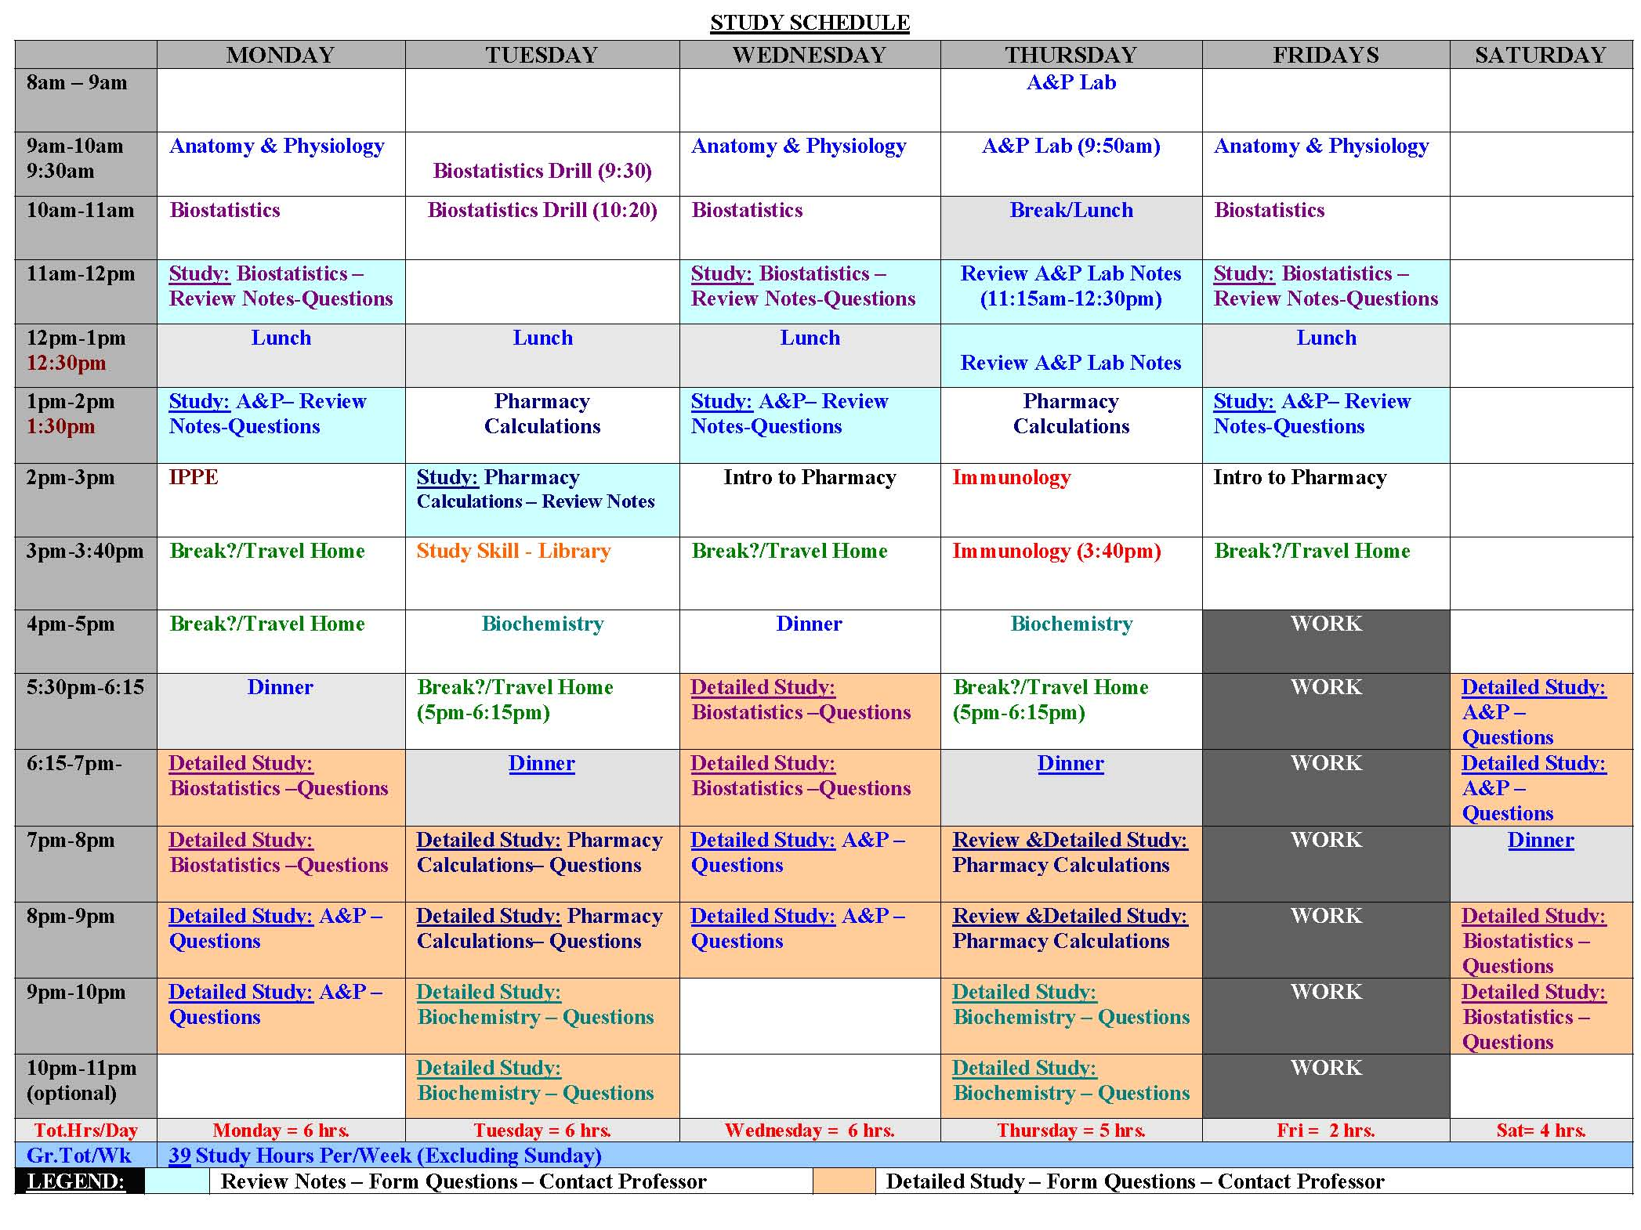
CREATE A STUDY SCHEDULE
SO YOU’RE
NOT
OVERWHELMED

Slide 5
Multiple-Choice Test-Taking Strategies
Read question carefully
Underline – Highlight – Circle important terms.
Eliminate! – Eliminate! – Eliminate!
Get rid of choices you know are incorrect at 1st glance
doing so improves chances of selecting a correct answer
Only change answers if you are absolutely sure the current answer is incorrect – Don’t second guess yourself!
Use time wisely – Pace yourself
Browse test and determine time to spend on each question.
Don’t ignore an obvious answer
Avoid patterns (i.e. selecting “C” just because…)

Slide 6
Example: Multiple Choice Question Type A
Type A questions deal with Basic knowledge, factual information and requires knowledge of information (simplest type)
Example:
What most frequently causes a tennis player to miss the ball completely?
Swinging too early
Swinging too late
Not watching the ball
Gripping the racket incorrectly
ANSWER: C

Slide 7
Example: Multiple Choice Question Type B
Type B question focus on application – These questions test knowledge in a specific context and requires more than memorization.
Example:
Billy, at age of two months, is very active and wiggles frequently. The findings of a study on the origins of temperamental or constitutional personality differences would predict that
Billy will be very quiet and docile by age 5
Billy will succeed in school
Billy will very likely be active and unable to sit still for long as a small child
Billy will be neurotic
How should you analyze this question?

Slide 8
Example: Multiple Choice Question Type B
Step:2 You might ask yourself, “what symptoms of the disorder appeared in the study?
Billy, at age of two months, is very active and wiggles frequently. The findings of a study on the origins of temperamental or constitutional personality differences would predict that
Billy will be very quiet and docile by age 5
Billy will succeed in school
Billy will very likely be active and unable to sit still for long as a small child
Billy will be neurotic
Step:1 Identify key words in the question stem
Step:3 This question requires you to recall definitions and to visualize how definitions can be applied in real life.
ANSWER: C

Slide 9
Example: Multiple Choice Question Type C (K-Type)
Type C (K-Type) require analysis, synthesis and evaluation in order to select an answer. K-Type questions require integration of knowledge and decision making.
Example:
A student suffers an injured ankle while running to first base in a softball game. The teacher examines the indicated area. The symptoms are typical of a sprained ankle, although the injury may in fact be more severe. Which of the following steps should be included in the first aid administered to the student?
Elevate the injured leg
Apply ice to the injured area
Apply direct pressure to the site of the injury
I only
II only
I and II only
I and III only

Slide 10
Example: Multiple Choice Question Type C (K-Type)
Step:2 You might ask yourself, “if the injury is more severe, then what other conditions could apply?
A student suffers an injured ankle while running to first base in a softball game. The teacher examines the indicated area. The symptoms are typical of a sprained ankle, although the injury may in fact be more severe. Which of the following steps should be included in the first aid administered to the student?
Elevate the injured leg
Apply ice to the injured area
Apply direct pressure to the site of the injury
I only
II only
I and II only
I and III only
Step:1 Read the stem carefully and identify key words in the question stem
Step:3 Although the stem implies that the injury MAY be more serious, it is not definitely stated; therefore the first aid administered should be based on a sprained ankle
ANSWER: C

Slide 11
Multiple Choice Question Types
TYPE QUESTION | STRATEGIES TO APPROACH QUESTION
Complete the Statement Given an incomplete statement that must be completed with answer. | Carefully read the question stem. Eliminate wrong answers immediately Read the question stem with each answer Make sure your answer choice BEST completes the sentence.
Which of the Following Choice of answers limited to answer stem only; although others answers could apply which aren’t listed. | Carefully read the question stem Insert the answer choices in place of the phrase “ which of the following”
Negative Choices “Not”, “Except”, “Least” – These words are often overlooked. Negative choices are used for questions with several GOOD solutions. BUT there is clearly a wrong answer in the choices | Carefully read the question stem Underline, circle, or highlight the negative word presented in the stem, so that you will select a correct answer. Think about what choice does not fit Keep in mind that you are looking for a negative choice – one that doesn’t belong.

Slide 12
The Power of Panic
A person who panics…
Relies on instincts instead of knowledge
Lacks an understanding of exam content
What happens when you panic?
Memory is inhibited
Ability to focus decreases
Tend to overlook stated facts
Easily become confused
Emotions take precedence over reason
Guessing is not strategic

Slide 13
Eliminate to Improve! (Process of Elimination)
Process of elimination is the most effective way to improve your chances of selecting a correct answer.
Eliminating Incorrect Answers
Details are important – watch the subtle differences in answers choices. (use question stem to find key text).
Answer choices must be logical
If reasoning for answer choice is not correct, then answer is not correct.
Incorrect Answers… Misrepresent a fact(s) Ignore the central issue in the question Have faulty reasoning | Correct Answers… State a fact(s) Address the central issue in the question Have sound reasoning

Slide 14
Eliminate to Improve! (Process of Elimination)
Process of elimination is the most effective way to improve your chances of selecting a correct answer.
Faulty reasoning includes:
Blatant contradictions
Goes beyond the facts
Assumes facts in dispute are true
When can a right answer be wrong?
When the answer choices include an option that is MORE CORRECT <OR> a BETTER OPTION.

Slide 15
The Guessing Game (intelligent deduction)
Do not guess until you have eliminated all known wrong answers
Look at the facts in the question stem
What issue(s) stand out?
<then> look for answer choice(s) that address the issue(s) presented in the question stem.
Beware of the following:
Distractors or Foils (incorrect answers that appear to be correct)
Absolute certainties (always, never, cannot must)
If two answers are opposites, one is probably correct.

Slide 17
Good Luck with Your Exams!
Dr. Blakley Director, Student Academic Performance & Support

