Slide 1
Unit 1:The Art of Story-Telling
from here to there

Slide 2
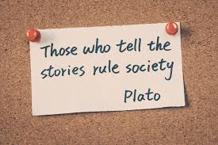
Today’s Goals
English 1:
Honors
Set up our binders for English 1
Explore the topic, standards, and essential questions to our first unit
Take a pre-assessment
Explore the topics, standards, and essential question to our first unit
Take a pre-assessment
Today’s Focus Questions:
What topics will we going to cover in Unit 1?
What will I be expected to do by the end of the unit?
How does this unit relate to the real world?
What do I already know about this unit?

Slide 3
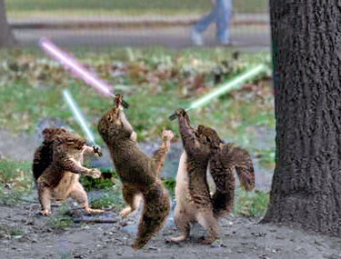
Unit 1 Overview
What will I be expected to do by the end of the unit?
How does this unit relate to the real world?

Slide 4
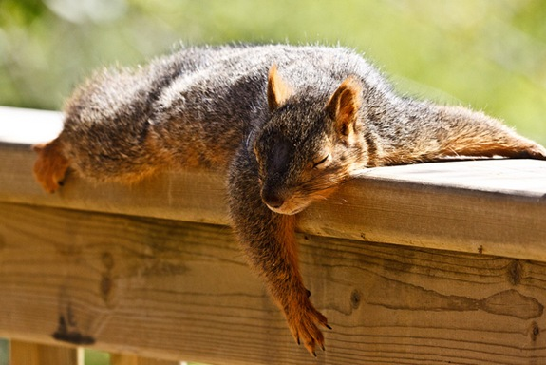
Narrative Text: The Art of Storytelling From Here to There
“It's like everyone tells a story about themselves inside their own head. Always. All the time. That story makes you what you are. We build ourselves out of that story.” ― Patrick Rothfuss, The Name of the Wind
We are surrounded by stories in our everyday lives, whether the headline in the news, the conversation in the hallways, or the songs jamming in our earbuds. This unit will introduce learners to the many facets of the world of stories through active listening, critical viewing, and close reading. We will challenge our perceptions of what makes up a story by delving into genre and its particulars, touching upon such topics as folklore, flash fiction, short stories, articles, memoirs, and film. Students will examine and analyze a variety of stories from perspectives and cultural experiences from outside of the United States in order to raise global awareness. Through this unit, students will combine their understanding of genre and culture to create their own stories using effective techniques. Ultimately, students will begin to break down stereotypes, cultivate empathy, and become mindful of the connectivity between stories and people who are different from us.
In one sentence of your own words, state what this unit is about:

Slide 5
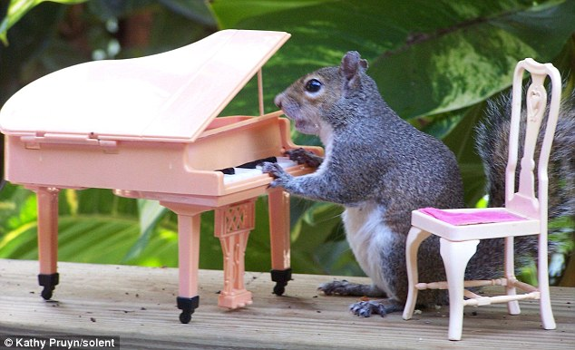
Standards
What are these standards asking you do to?
Why might this be an important skill to learn?
RL.9-10.7
Analyze the representation of a subject or a key scene in two different artistic mediums, including what is emphasized or absent in each treatment.
RI.9-10.7
Analyze various accounts of a subject told in different mediums (e.g., a person's life story in both print and multimedia), determining which details are emphasized in each account.

Slide 6
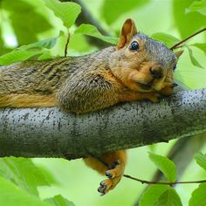
What we are focused on this Unit
What does the “W” stand for?
What is a narrative?

Slide 7
More on Writing Standard
Organize information and ideas around a topic to plan and prepare to write. .
Engage and orient the reader by setting out a problem, situation, or observation, establishing one or multiple point(s) of view, and introducing a narrator and/or characters; create a smooth progression of experiences or events.
Use narrative techniques, such as dialogue, pacing, description, reflection, and multiple plot lines, to develop experiences, events, and/or characters.
Use a variety of techniques to sequence events so that they build on one another to create a coherent whole.
Use precise words and phrases, telling details, and sensory language to convey a vivid picture of the experiences, events, setting, and/or characters. F
Provide a conclusion that follows from and reflects on what is experienced, observed, or resolved over the course of the narrative.
Develop and strengthen writing as needed by revising, editing, rewriting, or trying a new approach, focusing on addressing what is most significant for a specific purpose and audience.

Slide 8
Highlighters?
On the back page, highlight or circle things you believe you already know.
In another color, highlight or box the things you are most interested in learning.
Try to do this for each section

Slide 9
Essential Questions… what is it?
“An essential question is any question requiring one of the following thought processes:
a question which requires the student to develop a plan or course of action.
a question that requires the student to make a decision.
[They] are powerful, directive and commit students to the process of critical thinking through inquiry.
Answers to essential questions are a direct measure of student understanding.”
Thus, they will not be simple “yes/no” or definition type questions.
They will be opinion-based, deep-thinking, require research, and critical thinking skills.
Source: https://www.robeson.k12.nc.us/cms/lib/NC01000307/Centricity/Domain/3916/Writing%20Essential%20Questions.pdf

Slide 10
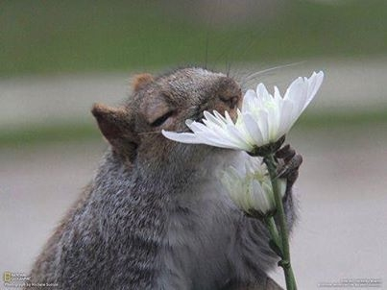
Unit 1 Essential Questions:
Why is storytelling an important aspect of a culture or society?
How can we use narratives to understand ourselves, others, and the world?

Slide 11
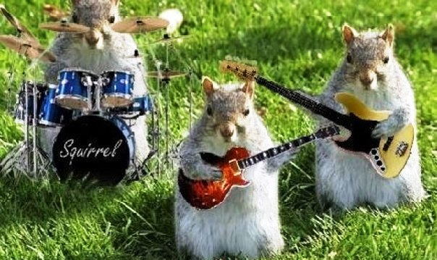
Core Vocabulary
Again, no real vocab tests… BUT:
You will be expected to be able to read a question using these vocab words and understand what it is asking.
Example: In the following story, how does the author’s tone contribute to the theme of acceptance?
Example: How does the Folk Tale genre enhance the story’s tension?

Slide 12
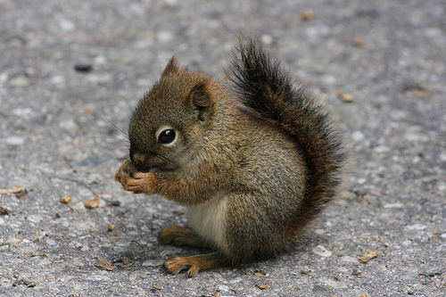
Focus Questions
These questions are sub questions of our essential questions.
By tackling these, we can get at the art of the others.
These smaller questions will be put into the PowerPoints everyday so you know exactly what you should know by the end of the lesson.
This Photo by Unknown Author is licensed under CC BY-NC-SA

Slide 13
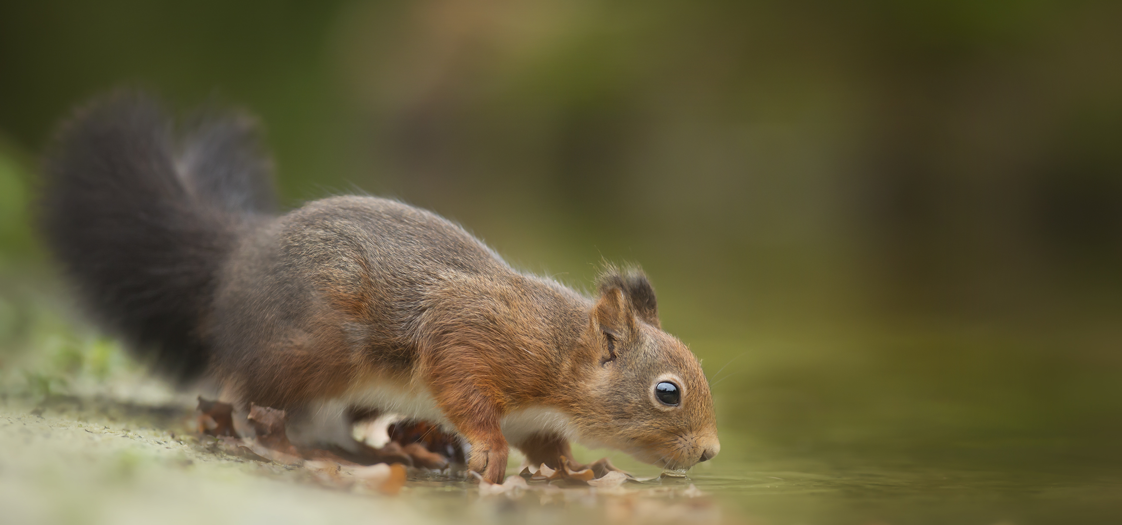
Student Outcomes
These are the specific things you will be able to do by the end of this unit.
use reading strategies to help comprehend what is read
read, identify, understand, and analyze the elements of a story
identify conflict within a plot and pull out text that shows these conflicts exist
make references to passages and events from a text to prove what the text is saying as well as any inferences I draw
write my own story using logical sequence of events and follow the constraints of a genre

Slide 14
Enduring Understandings
These are the concepts I want you to take with you for the real-world
This is the WHY to the WHAT
We tell stories to communicate what is important to us
Literary elements work together to convey themes and central ideas in text
Reading stories can be a means of self-discovery
Good stories engage the reader with a smooth progression of events, with purposeful dialogue and with vivid details
Similar stories can be expressed in different genres to convey different themes/ central ideas

Slide 15
Pre-Assessment/ Pre-test for Unit 1
What do I already know about this unit?

Slide 16
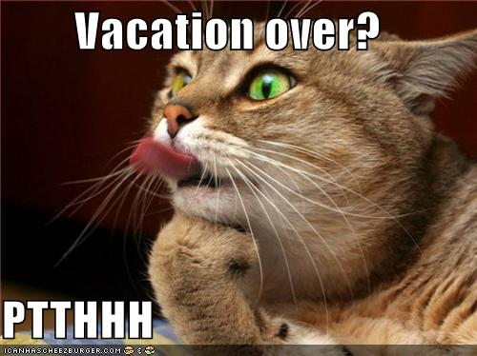
What do you mean a TEST?
Ahhh! We just got back from vacation!
Why are we taking a test already? ☹
I don’t know anything!
I don’t remember anything!
…calm down… let me explain.
This Photo by Unknown Author is licensed under CC BY-NC-ND

Slide 17
Why?
This assessment will:
Determine if what is being covered in the unit is already mastered, and allow the teacher to remove, reduce, add, or individualize instructions.
aka give you LESS notes, LESS review work, and MORE time towards learning
Measure true learning by comparing scores to the summative assessment to determine growth
aka help you SEE your own strengths and weakness so you’re no longer just “bad at English” or “bad at reading”
provide students with a “preview” of the unit’s expectations
aka figure out what we’re learning in the unit, and maybe see similar questions on the summative test…
spark new ideas for lessons to cover any knowledge gaps we come across
aka you guys understand concept A, and mostly B, so let’s do C that’s really fun since we’ve mastered A and are just reviewing B.

Slide 18
What? How? Honors
Take the test in class
60 questions
MC, diagram, Matching, Organizing
You have today AND tomorrow to finish
It will count towards your grade
But it WILL NOT hurt your grade
I want you to try your best
But I don’t expect perfection
I need to know what you know!
We will go over results
As a class, tomorrow
Test yourself!

